Slide 1
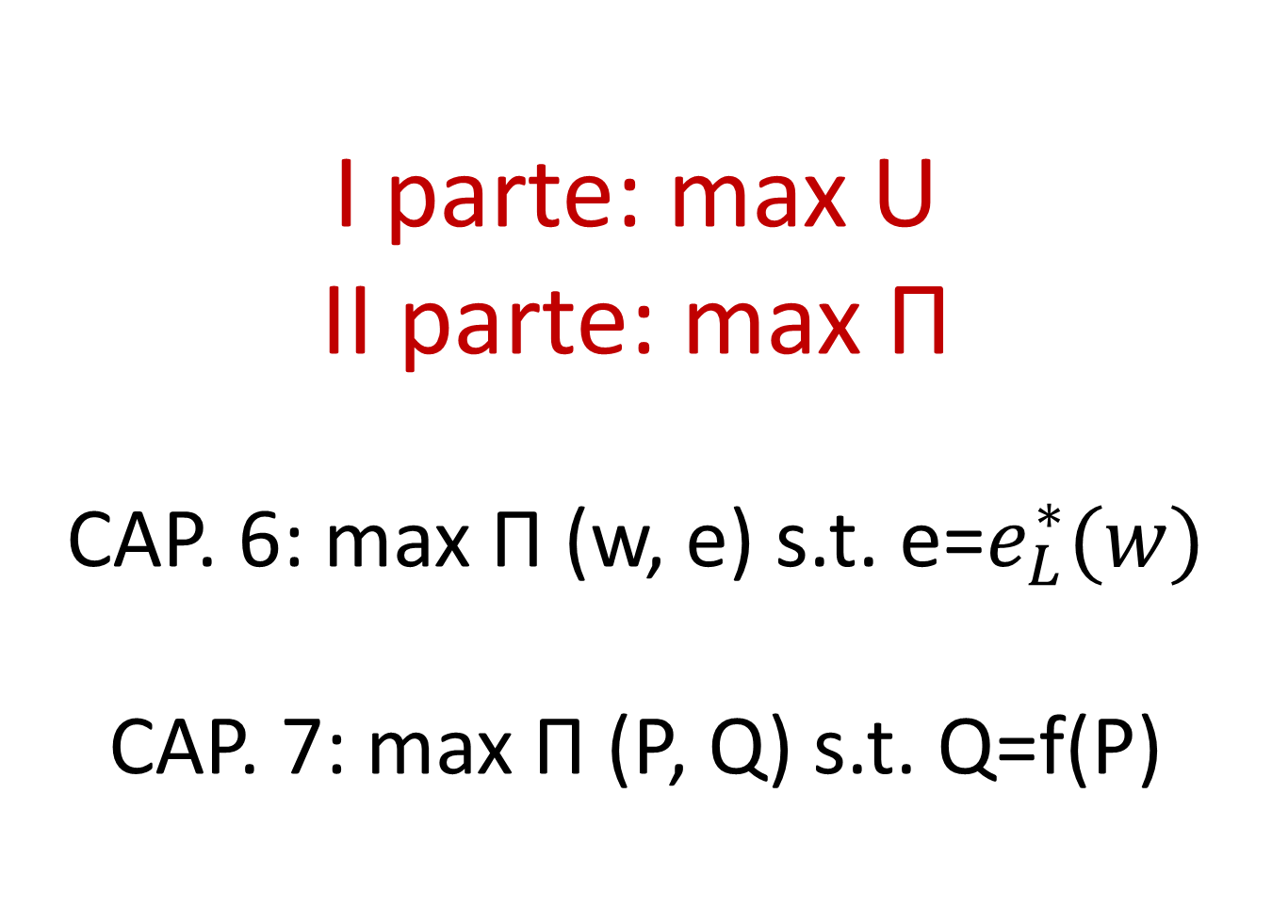
I parte: max U
II parte: max П
CAP. 6: max П (w, e) s.t. e=$e_{L}^{∗}(w)$
CAP. 7: max П (P, Q) s.t. Q=f(P)

Slide 2
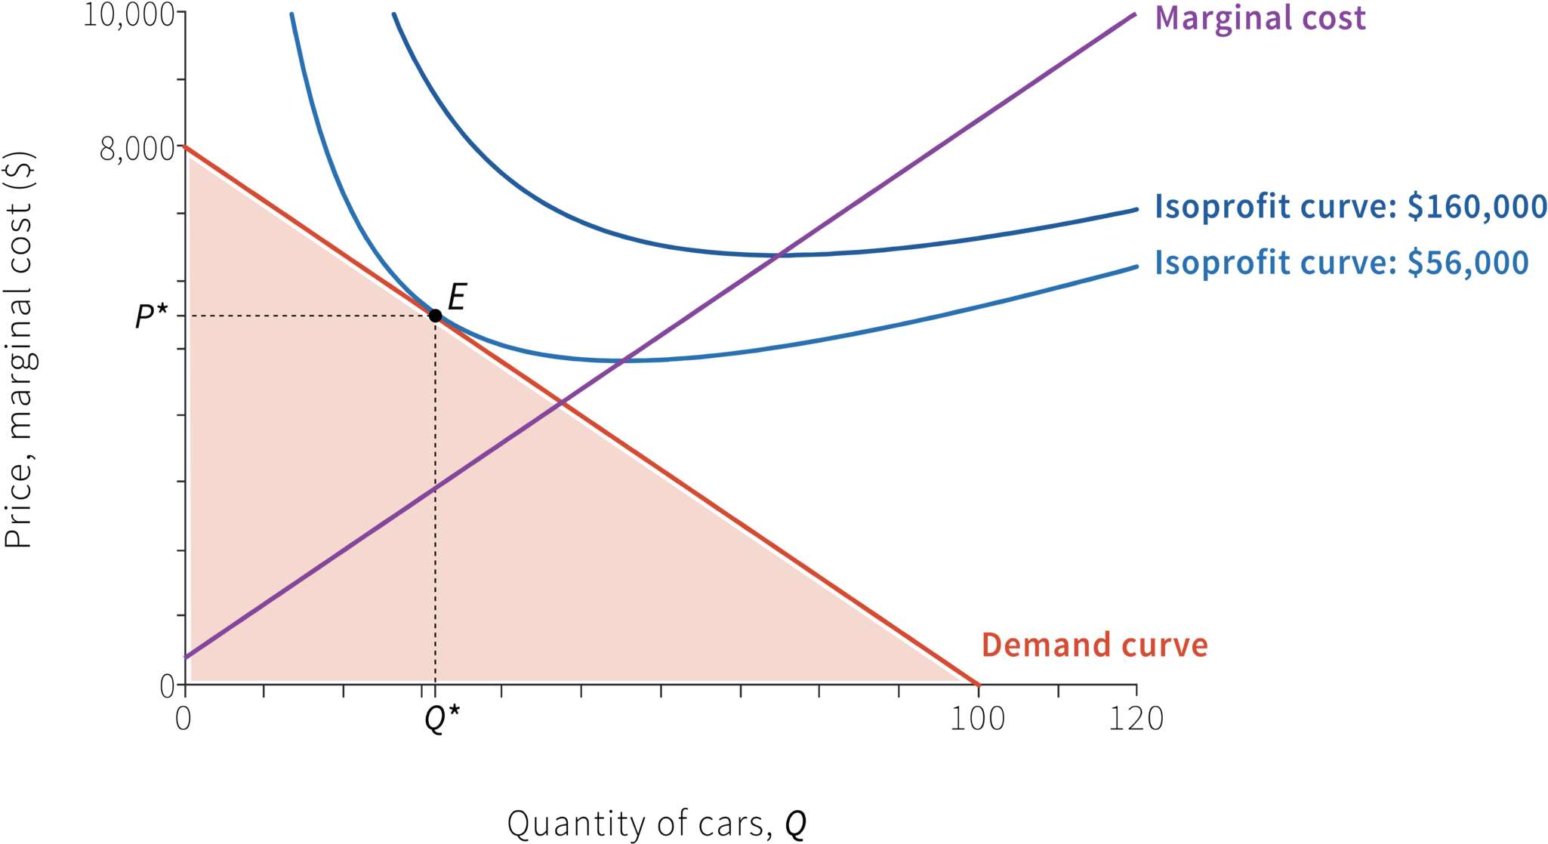

Slide 3
1. ELASTICITA’ DELLA DOMANDA potere di mercato (FISSARE IL PREZZO) ≠ da potere contrattuale (TAKE OR LEAVE OFFER CAP 3 e 4) e (ancora di più) da potere nell’impresa (CAPACITA’ DI IMPORRE SANZIONI, COSTI CAP 6)

Slide 4
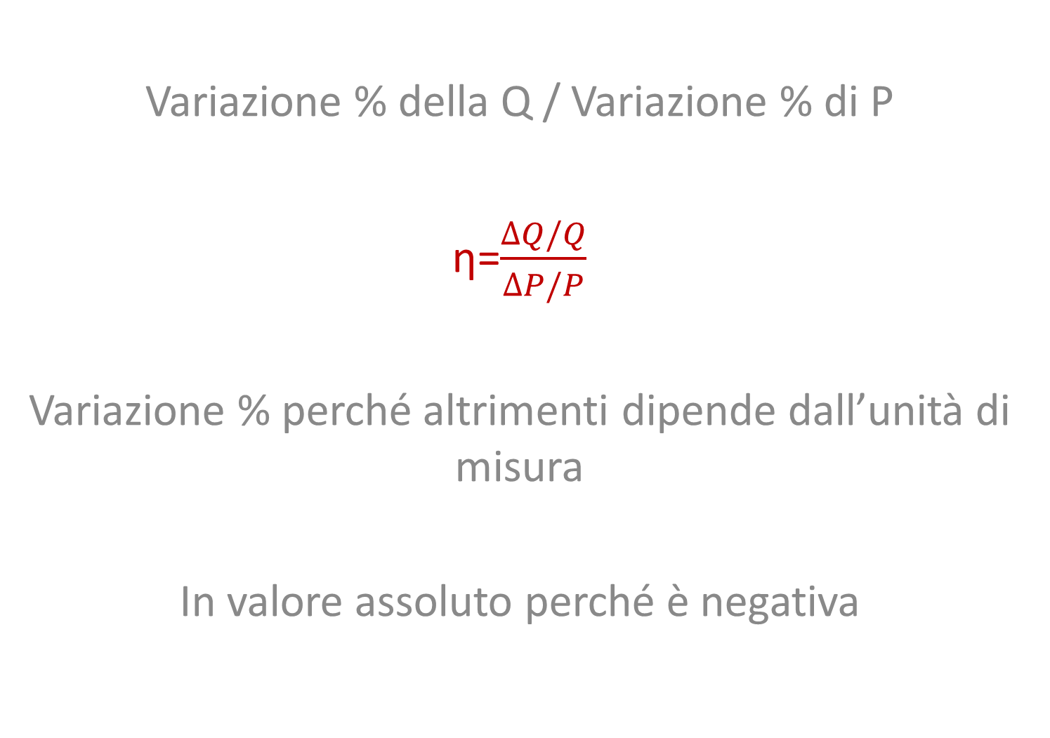
Variazione % della Q / Variazione % di P
η=$\frac{∆Q/Q}{∆P/P}$
Variazione % perché altrimenti dipende dall’unità di misura
In valore assoluto perché è negativa

Slide 5
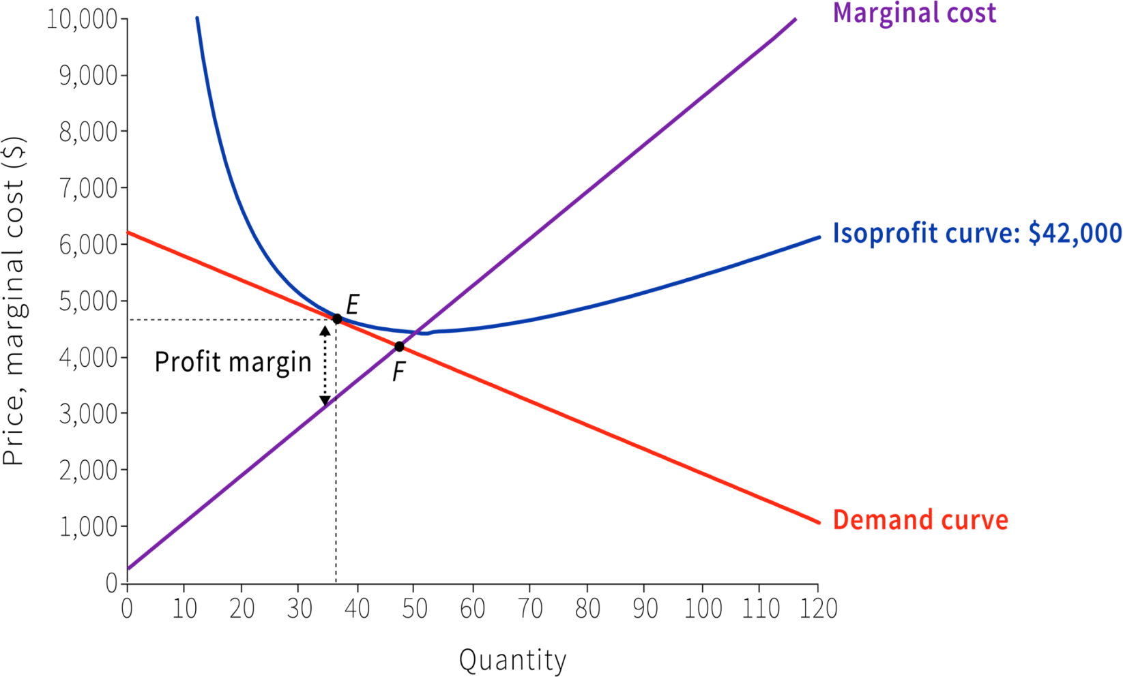
Domanda piatta → elasticità alta

Slide 6
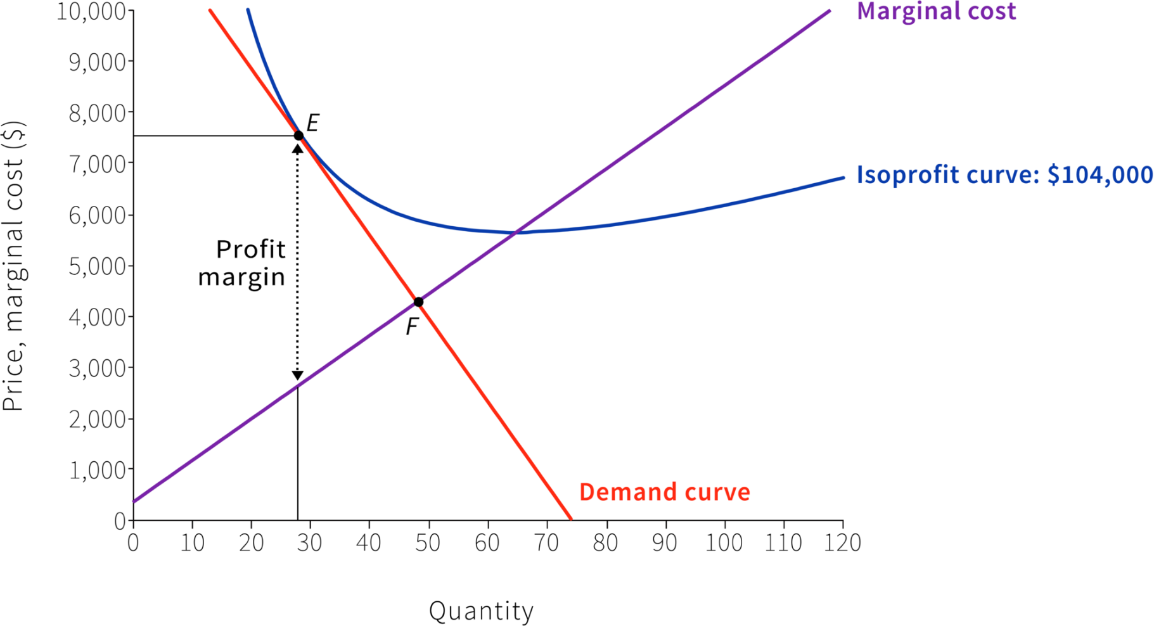
Domanda ripida → elasticità bassa

Slide 7
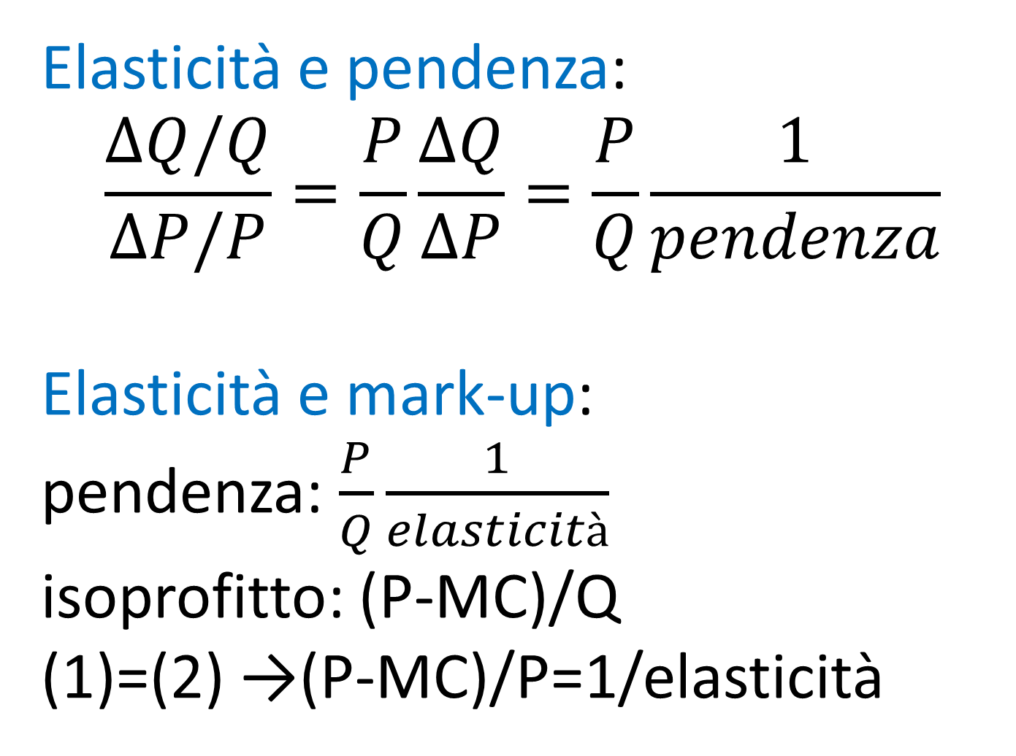
Elasticità e pendenza:
$$\frac{∆Q/Q}{∆P/P}=\frac{P}{Q}\frac{∆Q}{∆P}=\frac{P}{Q}\frac{1}{pendenza}$$
Elasticità e mark-up: pendenza: $\frac{P}{Q}\frac{1}{elasticità}$ isoprofitto: (P-MC)/Q
(1)=(2) →(P-MC)/P=1/elasticità

Slide 8
MONOPOLIO: la curva di domanda di mercato coincide con quella dell’impresa ed è decrescente
CONCORRENZA MONOPOLISTICA: la curva di domanda di mercato è ≠ da quella dell’impresa (ma sono entrambe decrescenti)
CONCORRENZA PERFETTA: la curva di domanda di mercato è decrescente ma la curva di domanda dell’impresa è piatta

Slide 9
Elasticità e tassazione
Pb: quali beni tassare?
Se elasticità è alta, la tassa riduce di molto le vendite e le entrate nn sono molto alte
Se elasticità è bassa, la tassa nn riduce di molto le vendite e le entrate sono alte
Trade-off: spesso i beni che hanno bassa elasticità sono beni di prima necessità →es. benzina
Altre volte i beni che hanno bassa elasticità sono proprio quelli da scoraggiare → es. tabacco , cibo malsano

Slide 10
Elasticità e spesa
Se elasticità <1, la spesa aumenta (con P che ↑)
Se elasticità >1, la spesa diminuisce (con P che ↑)

Slide 11
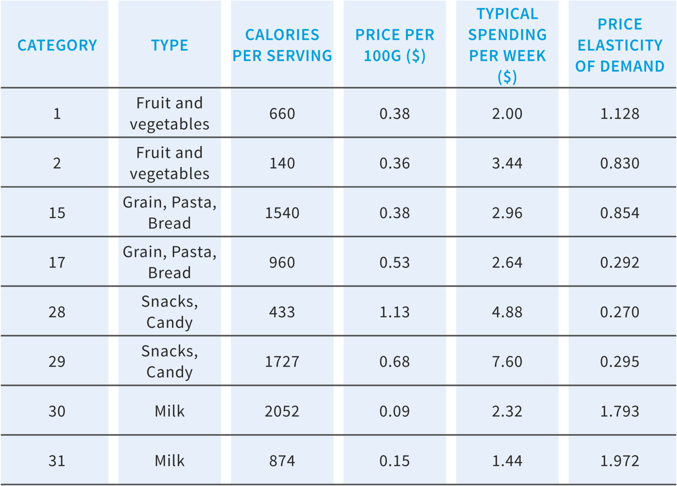

Slide 12
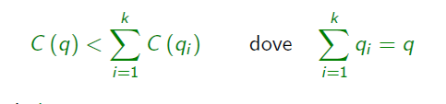
2. MONOPOLIO
(1 solo venditore)
POLITICHE ANTITRUST, CARTELLLI, COLLUSIONE EPLICITA O IMPLICITA (PD)
MONOPOLIO NATURALE (REGOLAZIONE, es. acqua e servizi pubblici in generale – prima delle innovazioni tecnologiche →es. telefoni)
Subadditività (e D):

Slide 13
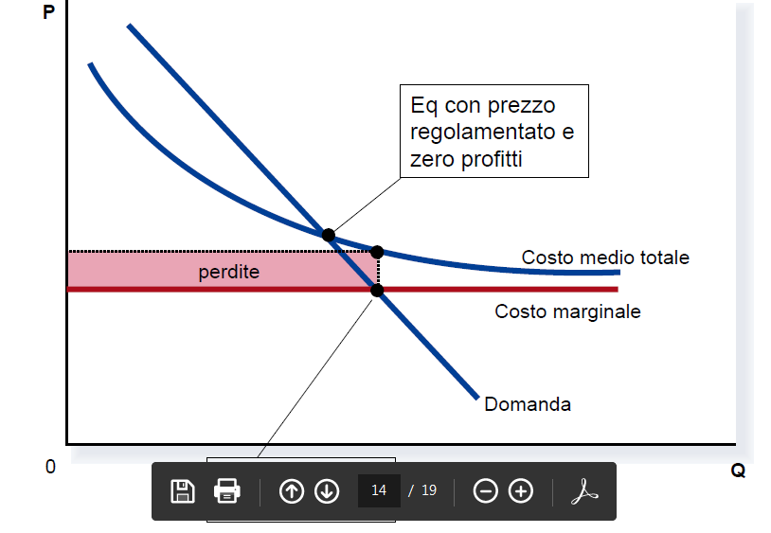

Slide 14
3. CONCORRENZA MONOPOLISTICA (differenziazione verticale e orizzontale)
Trade-off efficienza varietà
Politiche dell’impresa
Aspetto concorrenziale (sostituti e η)

Slide 15
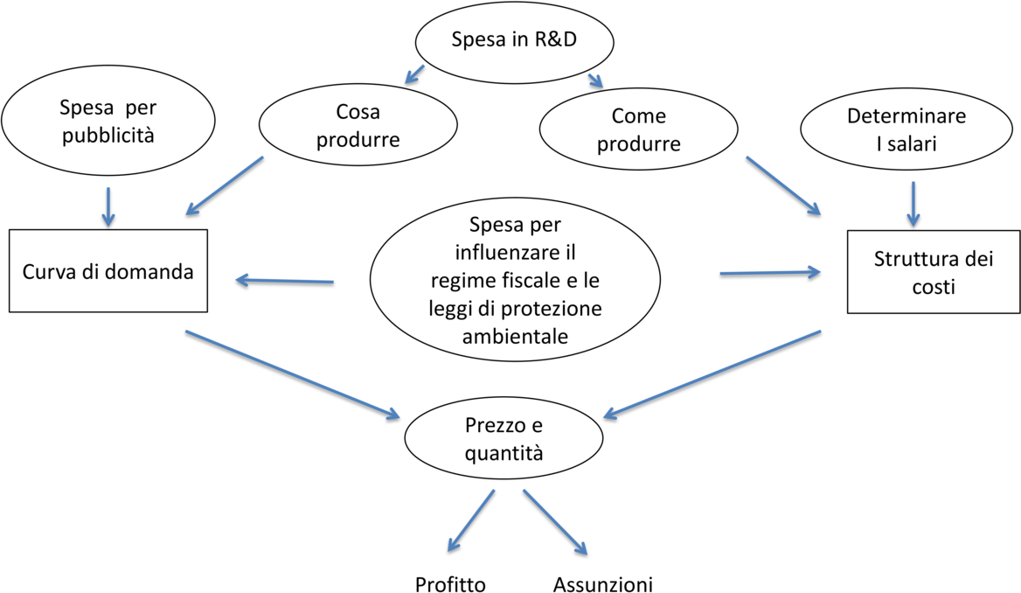

Slide 16
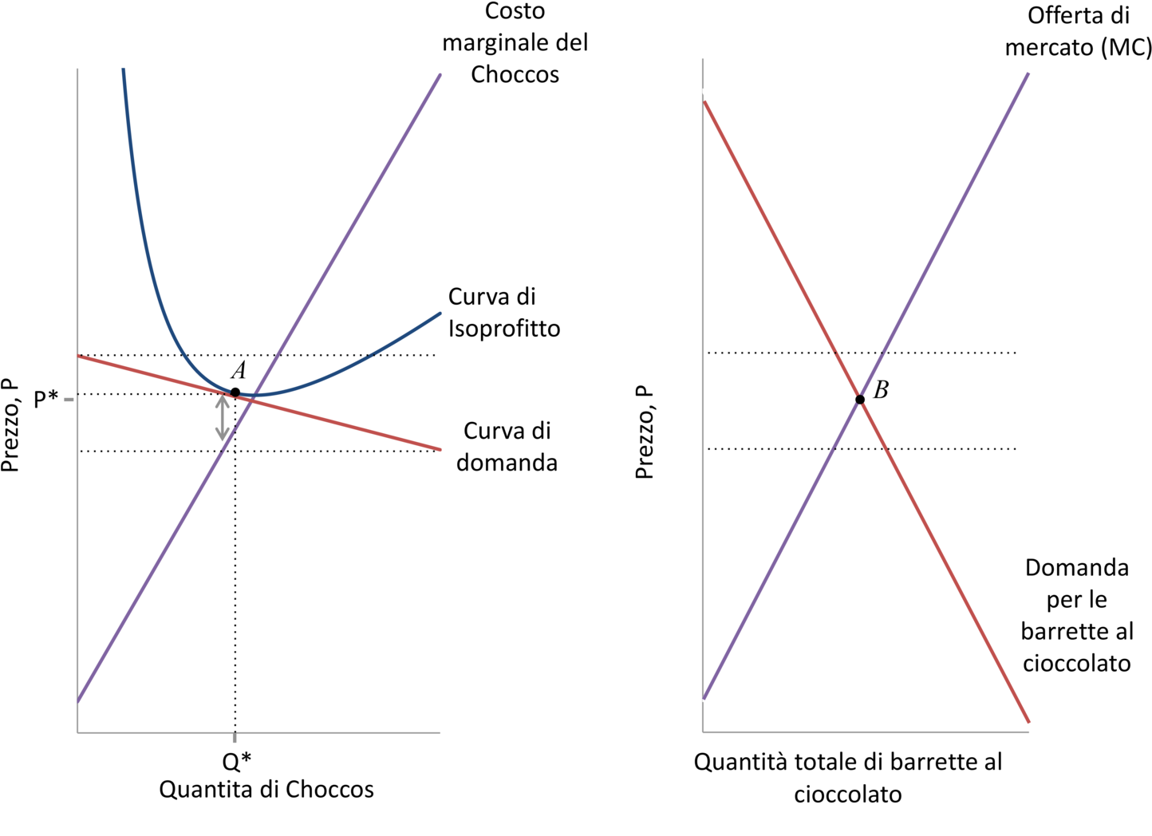

Slide 17
TEST UNDERSTANDING

Slide 18

UNIT 7. THE FIRM AND ITS CUSTOMERS

Slide 19
T7.1 Profit-maximising choice
Select all correct answers
The highest profit that the firm can make is $60,000.
The profit-maximising choice for the firm is where the highest attainable isoprofit curve is tangent to the demand curve.
The profit-maximising choice for the firm is where its marginal rate of substitution between the price charged and the quantity produced equate to its marginal rate of transformation.
The profit-maximising choice for the firm is at the peak of its profit function curve.
The following diagram shows the market demand curve of Apple Cinnamon Cheerios, the isoprofit curves of the producer firm, and the firm’s profit function curve. Based on the graph, which of the following are correct?
Section 7.1

Slide 21
T7.2 Returns to scale and economies of scale
Which of the following would contribute to economies of scale?
Select all correct answers
Large supermarkets being able to drive down the cost of purchasing milk as it increases its scale of business.
The expansion of the workforce requiring extra layers of management for better performance monitoring.
A merger of two firms leading to savings on the costs of HR, IT and legal departments.
The higher the number of users of Windows 10, the more likely it is that Microsoft will be able to achieve a higher sale of its operating system.
Section 7.2

Slide 22
T7.4 Fixed cost
Suppose that the marginal cost of producing a pound of cereal is $2, irrespective of the level of output, but there are also some fixed costs of production. Which of the following statements is correct?
Select one answer
The total cost curve is an upward-sloping straight line through the origin.
The average cost curve is U-shaped.
The marginal cost curve is a horizontal straight line.
The marginal cost curve intersects the average cost curve at its minimum point.
Section 7.3

Slide 23
ANSWER: T7.3 Average cost and marginal cost
The following is a table of the total cost (TC) of producing output Q for a particular firm. Based on this information, which of the following is correct?
Select one answer
The average cost at Q = 40 is £7.
The marginal cost at Q = 80 is £9.50.
The marginal cost is higher than the average cost at Q = 50.
The marginal cost curve intersects the average cost curve at Q = 60.
Feedback
The average cost at Q = 40 is £310 / 40 = £7.75.
The marginal cost at Q = 80 is (660 – 570) / (90 – 10) = £9.
At Q = 50, MC = (420 – 360) / (60 – 50) = £6 which is lower than AC = 360 / 50 = £7.20.
Section 7.3

Slide 24
T7.5 Consumer and producer surplus
The following figure depicts a firm’s profit-maximising choice at point E, given the market demand curve and the firm’s marginal cost curve. You are given that the firm’s marginal costs are $400, $2,960 and $4,200 at output levels Q = 0, Q* = 32 (point E) and Q₀ = 48 (point F), respectively. Based on this information, which of the following is correct?
Select one answer
The consumer surplus is $41,000.
The producer surplus is $120,320.
The deadweight loss is $20,000.
The gains from trade are $120,320.
Section 7.6

Slide 25
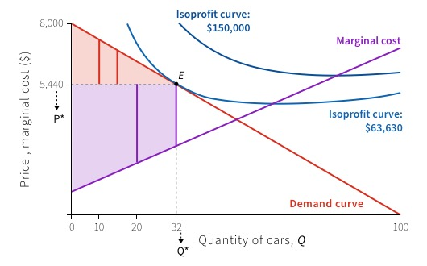

Slide 26
ANSWER: T7.5 Consumer and producer surplus
The following figure depicts a firm’s profit-maximising choice at point E, given the market demand curve and the firm’s marginal cost curve. You are given that the firm’s marginal costs are $400, $2,960 and $4,200 at output levels Q = 0, Q* = 32 (point E) and Q₀ = 48 (point F), respectively. Based on this information, which of the following is correct?
Select one answer
The consumer surplus is $41,000.
The producer surplus is $120,320.
The deadweight loss is $20,000.
The gains from trade are $120,320.
Feedback
The consumer surplus is the area of the pink triangle: CS = (8000 – 5440) × 32 / 2 = $40,960.
The deadweight loss is the area of the white triangle: DWL = (5440 – 2960) × (48 – 32) / 2 = $19,840.
d. The gains from trade are the sum of consumer surplus and producer
surplus: CS + PS = 40,960 + 120,320 = $161,280.
Section 7.6

Slide 27
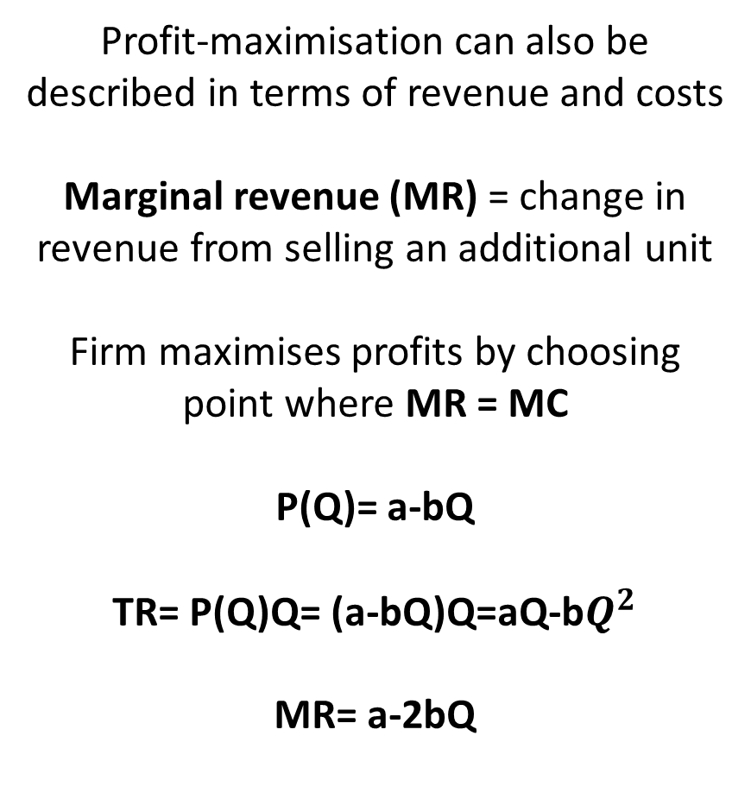
Profit Maximisation
Profit-maximisation can also be described in terms of revenue and costs
Marginal revenue (MR) = change in revenue from selling an additional unit
Firm maximises profits by choosing point where MR = MC
P(Q)= a-bQ
TR= P(Q)Q= (a-bQ)Q=aQ-b$Q^{2}$
MR= a-2bQ

