Slide 1
AlmaLaurea Employment Survey Network Alumni
Gianni Betti, in charge on behalf of the Rector for AlmaLaurea Employment Survey
JEUL Training for Placement Officer
SIENA 09/10/2018

Slide 2
AlmaLaurea: supporting graduates, universities and businesses
AlmaLaurea is a Interuniversity Consortium established in 1994 and currently counts 75 Universities as members (with the process of membership currently in the decision stage for 3 other ones) and represents about 90% of Italian graduates.

Slide 3
AlmaLaurea: supporting graduates, universities and businesses
The Consortium is supported and funded by the Universities that are part of it, by funds from the Ministry of University and Research (MIUR), by the companies and the bodies that use the services offered. From 2015 AlmaLaurea is member of SISTAN, the National Statistics System.
http://www.almalaurea.it/en

Slide 4
Missions - 1
surveys the Profile and the Employment status of the graduates annually after 1, 3 and 5 years, returning to the member Universities, to the MIUR and to the National Agency of Evaluation of the University System (ANVUR) reliable documents and data bases to simplify the decision processes and the planning of the student training, orientation and services activities;

Slide 5
Missions - 2
monitors the students’ learning paths and analyses the graduates’ features and performance at the university and in the job market, making it possible to compare different university courses and venues (universities);
collects and makes available online the resumes of the graduates (presently about 2,540,000) to facilitate the meeting between supply and demand of qualified jobs;

Slide 6
Missions - 3
evaluates the needs and professional profiles required by public and private, Italian and foreign companies and carries out staff selection and search via AlmaLaurea Srl, a subsidiary of the AlmaLaurea consortium, authorised by the Ministry of Labour to carry out staff research and selection

Slide 7
Missions - 4
internationalises its services, skills and research activities in a global perspective, cooperating with other European Countries in line with the Lisbon Strategy, and also non-European countries , focussing on the Mediterranean basin countries (Albania – GRADUA project) and most recently on Asian countries, especially China.

Slide 8
The Network Alumni
Through the web site https://alumni-unisi.almalaurea.it it is possible to:
From the Dashboard: to know the number of students that got a degree since 1999; see the list of these student; see all the news…
Search for students;
Select and create groups of students;
Create reports with tables and graphs from the database

Slide 9
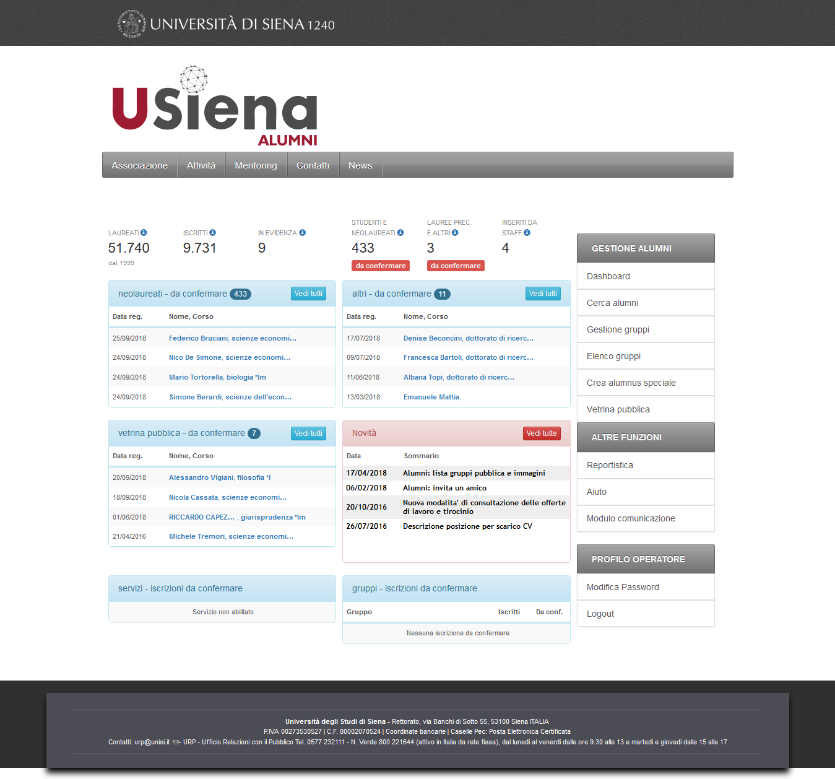
Dashboard

Slide 10
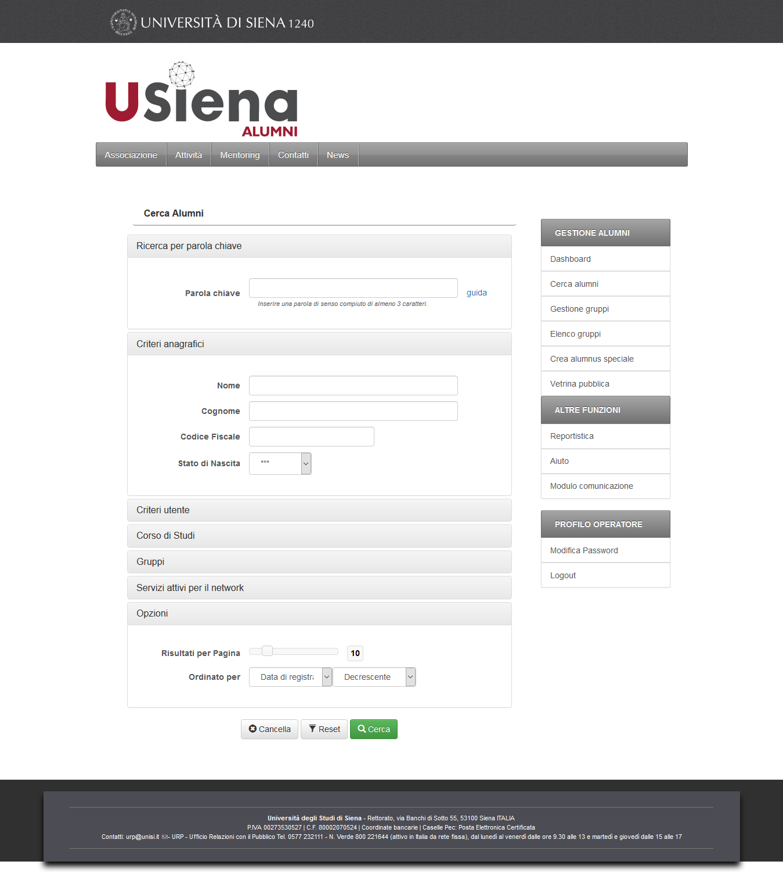
Search

Slide 11
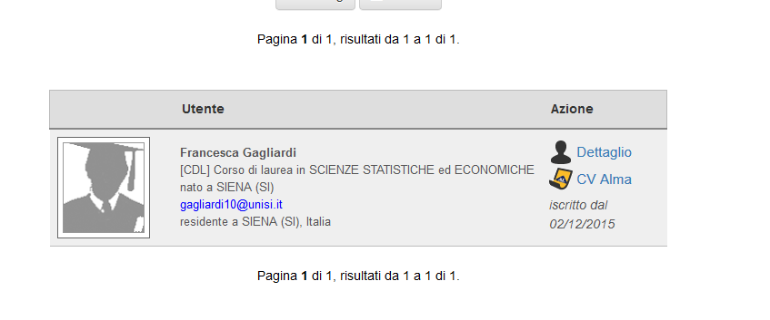
Result of a search

Slide 12
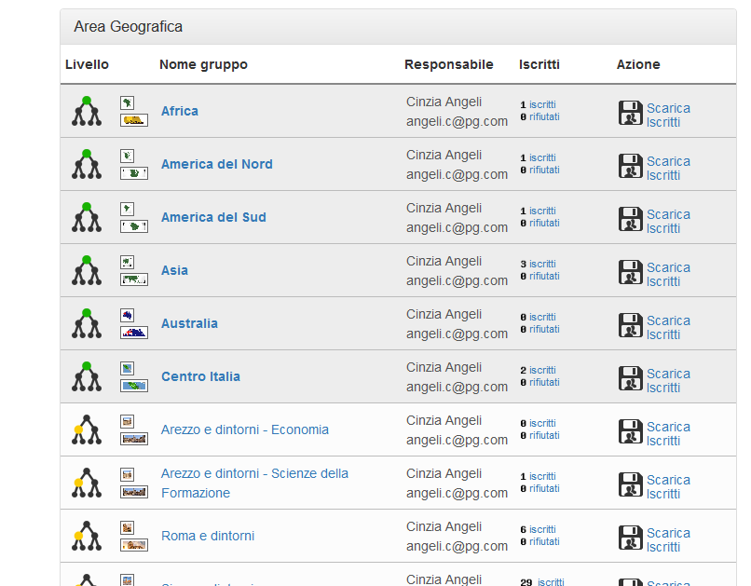
Group by geographic area

Slide 13
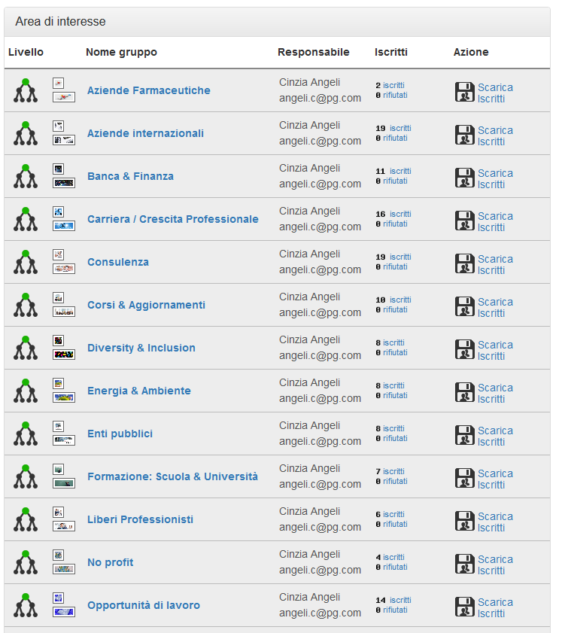
Group by area of interest

Slide 14
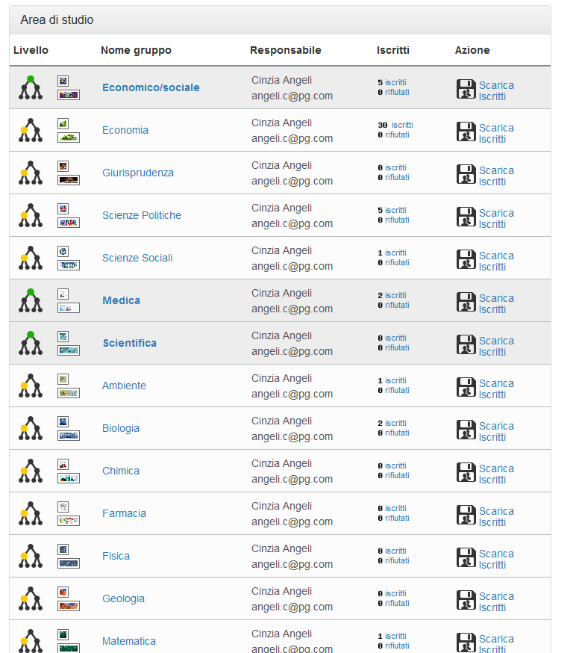
Group by subject of degree

Slide 15
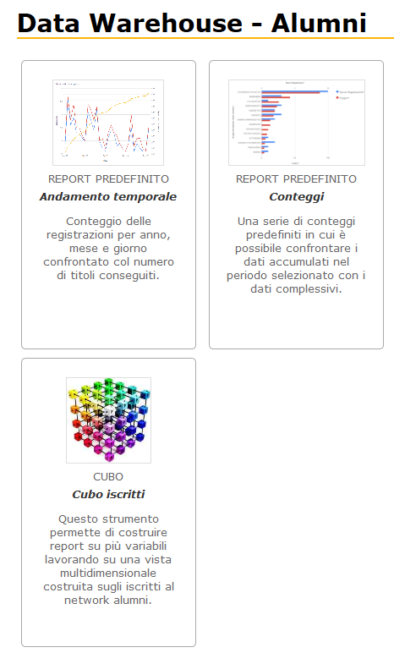
Reports page

Slide 16
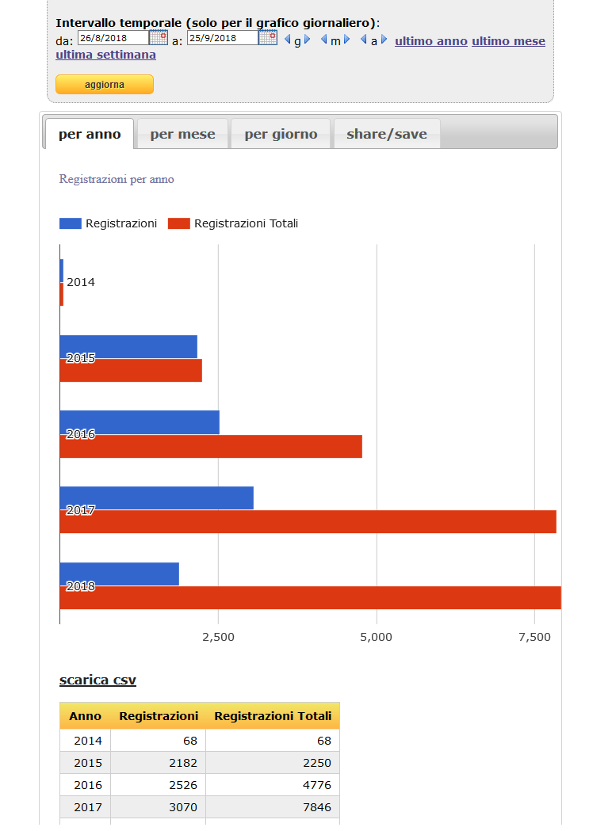
Number of students by year, month, day,….

Slide 17
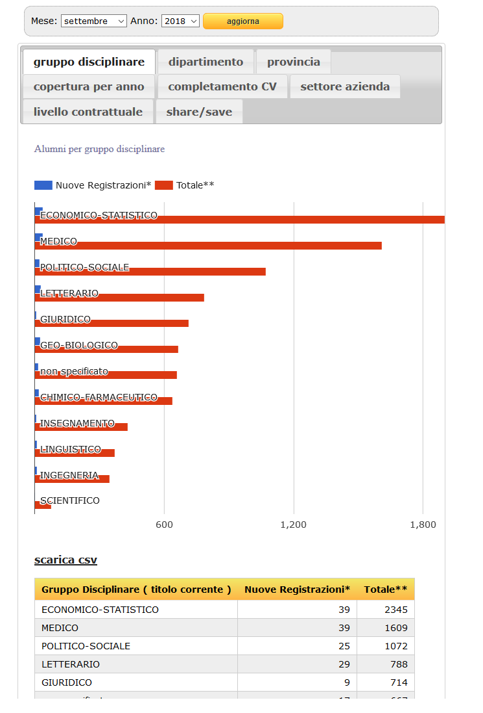
Number of students by subject of degree, by department,by province,….

Slide 18
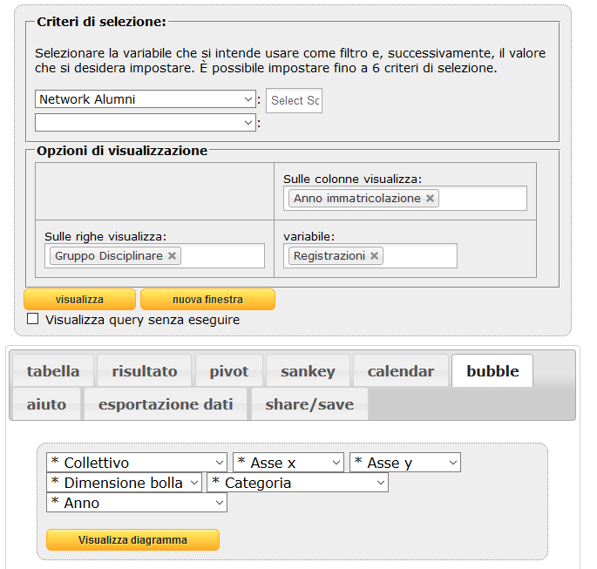
Cube report

Slide 19
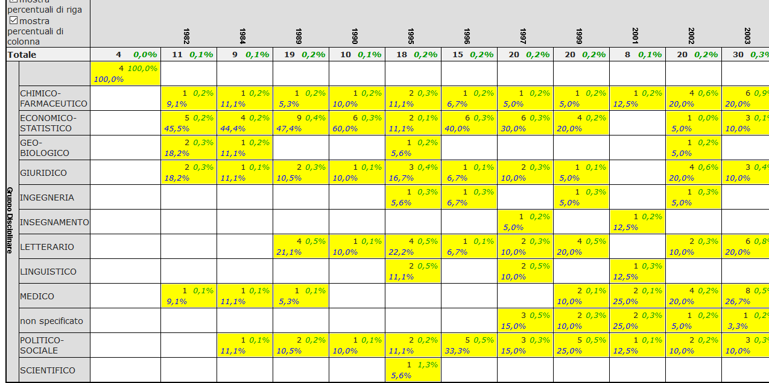
Table from Cube report

Slide 20
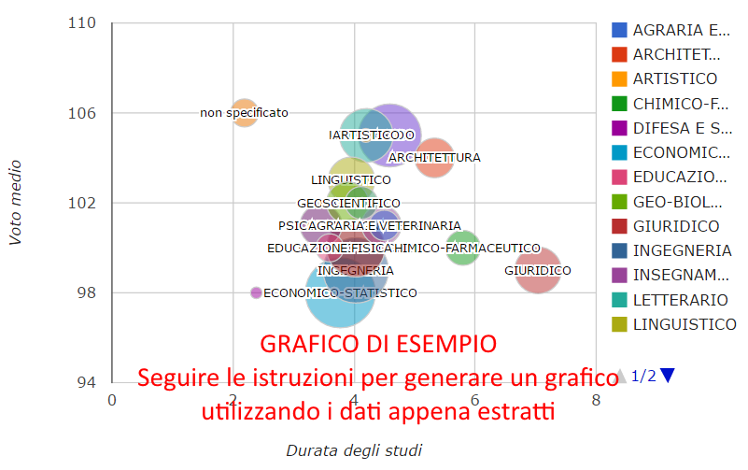
Bubble from from Cube report

Slide 21
Thank you for your attention!

