Slide 1
Dottorato 2021 Lecture 1 On pre-capitalist economic formations - Battlefields in Economic Anthropology, Archaeology and Ancient History
Sergio Cesaratto
sergio.cesaratto@unisi.it
(revised 3 May 2021)

Slide 2
Substantivists/Primitivists versus Formalists/Modernists
Karl Polanyi (anthropologist 1886-1964) argued that in primitive or ancient economies the economy is not a sphere separate from interpersonal relations, it is 'embedded'; only in capitalism through the market does the economy become disembedded.
Rejection of homo economicus. Rediscovery of the economics of gift and reciprocity (Malinowski, Mauss). See Marchionatti e Cedrini (2017) for a modern reappraisal.
Moses Finley (Cambridge historian 1912-1986) argued that in the Greek-Roman economies extra-economic moral values and political institutions prevailed over economic interests, an echo of Karl Polanyi’s thesis that, before capitalism, the economy did not constitute an autonomous social sphere.
Notably, both Polanyi and Finley identified the economic sphere with the market, and eventually the economic discipline with marginalism. This is misleading.
We shall argue that the classical surplus approach revived by Piero Sraffa is a third way: an economic approach in which the economic sphere does not coincide with exchange. Moreover, the surplus approach is intimately linked to the analysis of institutions, understood as the social forms in which the production and distribution of surplus is ordered.
Institutions exists in order to regulate social conflict over income distribution (Ogilvie 2007)

Slide 3
Marginal imperialism
Adam Smith is often regarded as the forerunner of homo economicus (natural disposition to trade)
Late XIXth century, early debate among German historians at the time of the controversy over method (between the German historical school and Menger)
The debate between M. J. Herskovits – the author of the first textbook on Economic anthropology (widely relying on the concept of economic surplus) and Frank Knight followed in the 1940s.
Debate with Polanyi (1960s): marginalist economics can be useful for interpreting primitive and ancient economies (differences in degree not substance)
Debate with Finley (1980s): ancient societies were market societies, but information asymmetries were an obstacle to the full development of markets. This however lays the groundwork for explaining the institutions of ancient societies. Institutions as social devices to reduce transaction costs (NIE).
Power relations and exploitation often explained in terms of protection from violence (this would explain taxation in the Roma empire or serfdom). Sam Bowles?
Incidentally: NIE or rather transaction cost economics can be a useful theory for industrial economics and the applied economist, but certainly a poor explanation of political institutions. In the classical surplus approach, structure (economics) and superstructure (institutions) are in a sense indistinguishable, and one needs the other.

Slide 4
The surplus approach
P – N = S
where S is that part of the physical net social product P (net of reproduction of the means of production) which is left once workers’ “necessary consumption” (or wage goods), N, are paid. The social surplus S can be defined as the part of the social product P left once society has put aside what is necessary N to reproduce the social output at least at the current level and that can thus safely be used for any other purpose.
The surplus approach is third way between the substantivists and the formalists (although closer to the former).
It does not identify the economic sphere (necessarily) with the market - the big mistake made both by Polanyi and Finley, and of course by the marginalists.
Income distribution (not the market per se) is the core of economic analysis (as Ricardo well understood).

Slide 5
The core of classical analysis
Three “circumstances” are taken as given when approaching the determination of the social surplus: a) the level and composition of output, b) the technical conditions of production, and c) the real wage. The analysis of the three categories of “data” is deferred to a different, further stage of the investigation. Combining these data as in figure 1 the “shares other than wages (surplus)” can be determined (Garegnani 1984, p. 293):
(a) Social product
(b) Technical conditions Labour employment Profits
(c) Real wage Necessary consumption
inner relations (black arrows): circumstances (a) and (b) determine labour employment that, along with (c), regulates necessary consumption; surplus profits are finally determined on the basis of equation (2). The “data” (a), (b) and (c) are investigated out-of-the-core. Source: Garegnani 2018, p. 622.

Slide 6
From capitalism to pre-capitalism
Sraffa and Garegnani (as well as Marx and Ricardo) applied this analytical scheme to capitalism.
But the classical tradition (and also Marx) suggested the scheme of surplus as the analytical key to understanding the whole of social-economic history. It is a long tradition still present (perhaps unconsciously) in the disciplines of anthropology, archaeology, and ancient and medieval history.

Slide 7
Stage theory
To anticipate my thesis: the surplus approach is the study of income distribution under different, historically given economic formations, each characterized by different institutional mechanism that preside over the production and distribution of the social output and eventual surplus.
The idea of different economic formations characterizes the surplus approach since its sunrise in the XVIIIth century. The idea of stages of economic develoment was suggested by the geographical “discoveries” and contact with primitive societies (primitive hasn’t any depreciative meaning). Note that a “moral” debate on the social nature of those formations was initiated by J.J. Rousseau (the “good savage”), or by Hobbes (homo homini lupus)
According to pre-classical authors, Meek (1976) argues, “societies undergo development through successive stages based on different modes of subsistence”. Four stages emerged as prevalent, as also finally ratified by Smith (probably already in the Lectures on Jurisprudence in the early 1760s): hunting, pasturage, agriculture and commerce. Based as they were on inference from the early reports from the newly discovered lands, in particular from the Americas this classification does not disfigure in view of modern research.
A very materialist interpretation of history: social organization changes with its material foundations.

Slide 8
Marx on pre-capitalist formations
Marx was obviously interested in showing that capitalism was a particular and historically determined economic formation. Of immense culture, Marx was very interested in the early anthropological studies conducted by Lewis Henry Morgan (1818-1881) on a materialist basis.
In the simplest version, an economic formation comprises structure (mode of production) and superstructure (institutions, culture).
The mode of production concerns the relationship between labour and the means of production.
In the most schematic version, for example,
- hunter-gatherers (primitive communism): absence of ownership of the means of production;
- slavery: both labour and means of production privately owned
- serfdom: semi-free labour retaining ownership of the means of production
- capitalism: free labour, private ownership of the means of production.
- Asian mode of production (?): free labour controlling the means of production, but storage of the product at the palace (Palatial system) and redistribution (Mesopotamia?)
We do not have a complete view of Marx, who is in any case very flexible (modes of production overlap and coexist, perhaps with one dominating, nuances are endless etc.).
There is a very interesting and non-ideologised recent Marxist debate on this.

Slide 9
Mechanical Marxism
Mechanical version of Marx’s theory:
Change in the structure (technical change) → change in the superstructure
Rigid classification of economic formation
There is a very interesting and non-ideologised recent Marxist debate on this (Banaji 2010; Haldon, J. (2013).
Be this as it may, the surplus approach has been widely applied in economic anthropology, archaeology and history of pre-capitalism.

Slide 10
Surplus and “civilization”
At the heart of the surplus approach is the idea that "civilisation" as we understand it presupposes the existence of a surplus, i.e. that only part of the population is needed to ensure subsistence and that the remainder can engage in " superior" activities.
We find this approach for example in:
- Economic anthropology: Melville Jean Herskovits (1895-1963), J. Diamond and many others. The use of the term 'surplus' is widespread.
- Archaeology: Vere Gordon Childe (1892-1957) the greatest archaeologist of the last century (Marxist, communist and eccentric); many archaeologists more or less in a Marxist tradition, such as Andrea Carandini, Mario Liverani, Marcella Frangipane and the school of La Sapienza in Rome. The use of the term 'surplus' is widespread.
Childe permeated our way of thinking about the transition between prehistory and history (Neolithic revolution--> transition from hunter-gatherers to agriculture; urban revolution --> surplus and birth of cities)
- History of Ancient Civilizations: the concept of surplus is clearly adopted by Marxists like Perry Anderson’s classics (1974) (famous and worth reading, but a bit updated); and Geoffrey Ernest Maurice de Ste. Croix (another great eccentric Oxford marxist), but it is widespread. de Ste. Croix asked the correct question: “How, otherwise, did that class (…) derive its surplus?” (the answer was: from slavery).
Note that even marginalists indulge in using the term surplus (they do not dear to applay their marginal product theory to ancient economic formations!).

Slide 11
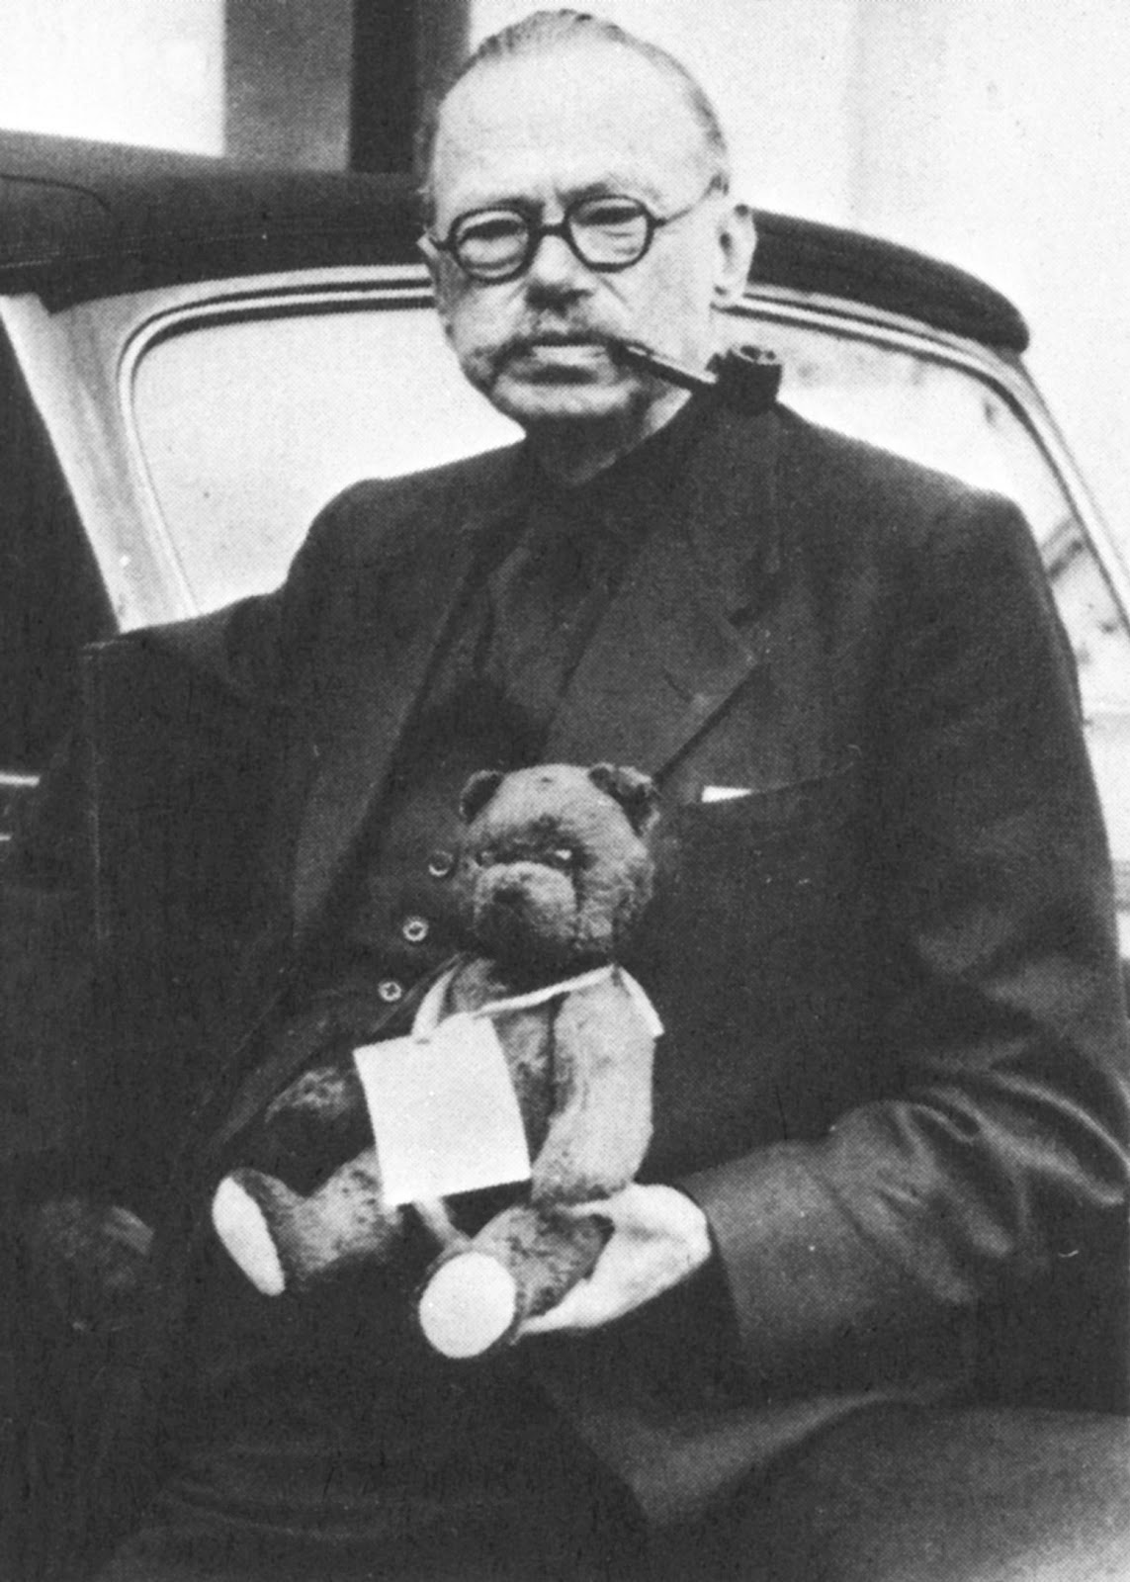
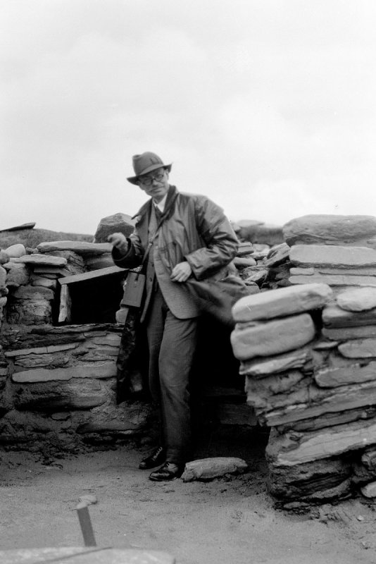
Vere Gordon Childe (1892-1957)

Slide 12
The surplus approach wins the Pulitzer (short digression on Jered Diamond)
Until about 11,000 years ago, the human population consisted of hunter-gatherers. Agriculture and domestication of animals, and with them more stable and complex sedentary social structures had not yet developed. Indeed, only with agriculture did humans begin to produce a storable food surplus that enabled them to reduce mortality, increase in numbers and support a larger population, part of which consisting of a class of “unproductive” workers dedicated to political–military organisation and to the discovery and preservation of knowledge: food surplus makes it possible to support unproductive groups of bureaucrats, scholars and soldiers, but also artisans. The emergence of the surplus is therefore also associated with the appearance of social stratification.
The production of a food surplus did not however occur in all the regions inhabited by Homo sapiens. According to Diamond only some regions had a sufficient variety of plants and animal species suitable for domestication to make it worthwhile for hunter-gatherers to become farmers. With regard to agriculture, consider that only a tiny minority of the thousands of plant species are edible, nourishing and suitable for cultivation, or otherwise allowing a range of crops that could be readily cultivated with a high yield. These species did not occur in all regions of the world. Only in a few areas was there an array or package of varieties with nutritional properties (for example, the right combination of carbohydrates and proteins), cultivability and yield such as to make farming more advantageous than hunting and gathering.

Slide 13
Diamond (cont.)
The discovery that plants could be grown from seeds was not enough to convert humans to farming; it was the geographical availability of suitable varieties that determined which populations developed agriculture and which did not. Similar considerations hold for animals, of which only very few species can be raised in captivity, and among these even fewer large ones can be domesticated for transport, work and war, as well as for producing milk, hides, etc. A substantial package of such animal species only occurred in certain parts of the world due to appropriate climatic conditions, giving those fortunate populations another enormous advantage. Food surplus generated population growth and a surplus of manpower that could be diverted from material reproduction and allocated to higher activities such as politics (yes!), war and the accumulation of knowledge, among the latter the invention of writing and numbers (probably emerging from the need to keep records of the amount of agricultural surplus in storage). Sedentary life rendered advantageous the development of constructions and complex artefacts that could not be transported and were therefore of no use to nomadic peoples.
The generation of a food surplus occurred in the Fertile Crescent (Mesopotamia), China, Central America, the Andes and what is now the eastern United States. Mesopotamia developed the “wheat-barley-peas-lentils” package, China “rice-millet-soy”, and central America the less nutritious “maize-beans”. The number and quality of animal species suitable for domestication made the difference: in the Americas, there were only turkeys and lamas (the latter in the Andes). In those lands, there were no beasts of burden and so the wheel was not invented or at least not used, and their absence also held back agriculture and the development of ploughing, transport and so forth. There was also a lack of close contact with domestic animals. In other places, this proximity transmitted major epidemic diseases such as smallpox, measles, influenza and the plague to man, leading to resistance and immunity in survivors. The spread of these viruses in lands conquered by Europeans amounted to a biological weapon that almost exterminated native populations.

Slide 14
Diamond (cont.)
The geographical disposition of Eurasia also enabled a faster spread of natural species and human knowledge between regions with a relatively similar climate at similar latitudes. In contrast, the longitudinal disposition of the Americas, interspersed with deserts, impeded this spread. And of course, other lands were isolated by oceans.
In conclusion, notice the language used by Diamond—surplus, subsistence, productive and unproductive labour —the same we find used by classical economists. As I said, Diamond does not cite any economist, classical or marginalist. This demonstrates how little use “modern” economics was to him. At the same time, however, we can presume that Diamond was hardly exposed to the ideas of classical economists like Anne-Robert-Jacques Turgot (1727–1781) and Adam Smith (1723–1790) who advanced theories that anticipated that of Arms, steel and germs on the basis of the first reports from the new lands just then discovered.
(notes taken from Cesaratto 2020, Chapter 2).

Slide 15
Problems with the surplus approach
Polanyians raised the question of the origin of surplus. They rightly maintained that there have to be social mechanisms through which potential surplus is transformed into actual surplus. In other words, the surplus does not arise spontaneously.
There are hunter-gatherer societies that have a potential surplus, but deliberately do not exploit it, or dissipate it, or destroy it.
Of course, it is with agriculture that the surplus emerges in a systematic way, but again, the exploitation of this potential is not automatic, historical processes must be identified through which, in particular, elites have appropriated the surplus.
Moreover, the very adoption of agriculture does not appear to have been beneficial to many H-G populations: they fared better as H-Gs in terms of diet, labour effort and (fairly egalitarian) social relations (here Marshall Sahlins' contribution is crucial).
As Polanyian Pearson (1957) wrote: the concept of surplus ‘is useful only where the conditions of a specific surplus are institutionally defined’ since ‘[t]here are always and everywhere potential surpluses available. What counts is the institutional means for bringing them to life’.“
This is a reaction to a mechanical Marxism (e.g. Gordon Childe?) that regarded social evolution, especially in prehistoric period, as the result of technological revolutions set off by improvements in production techniques.

Slide 16
Storage and social stratification
Polanyi’s criticism must be welcomed. The origin of the institutional mechanism that transformed technical opportunities (potential surpluses) in new social relations of production and distribution is as much important (or even more important) than technology per se.
There are crucial issues to be studied in this area, and they have to do with the origin of inequality:
-H-G egalitarianism is a 'natural' factor (Rousseau) or an institutional/artificial mechanism (suppression of emerging/dominant figures);
- how did ancient populations move from potential agricultural surplus to its appropriation by an elite?
In Neolithic societies with the agricultural revolution, storage became systematic and massive, and control of the warehouses by an élite constituted the key step for stratification (see Frangipane 2019).
Since harvests are typically periodic, the very possibility of storing the product for seeding and deferred consumption is a prerequisite of agriculture. Storage also makes it possible to set aside some surplus over normal replacement requirements and subsistence in anticipation of unfortunate future events, such as famines, floods, etc. These surpluses are referred to in the literature as "normal surpluses. Storage in turn implies its social management and defence against potential enemies.
“Normal surpluses” may thus constitute an intermediate step towards stratification. The management of warehouses and "normal surpluses" may provide priests or personalities who impersonate the fortunes of the community with the occasion to transform themselves into the dominant élite.

Slide 17
Some conclusions
Explaining a historical formation means describing the institutions that preside over the production and distribution of surplus.
Exchange (the market) may be a part of it in all human societies, although it assumes a central role in capitalism. In capitalism, exchange - as Marx understood - is a manifestation of the mechanisms for distributing surplus. In pre-capitalist formation “personal relation” might matter (e.g. savery or serfdom).
Where to go?
We want to overcome the opposition between sustantivists/primitivists (it's all institutions) versus formalists/modernists (it's all markets).
The problem is to reconstruct the social texture of those societies with their distributive and power relations. In all societies market and non-market are present, sometimes in conflict, sometimes not.
For Marxists, or in general for the surplus approach, there are formidable methodological problems on how to characterize economic forms that see the coexistence of different modes of production.
Everything is simplified in marginalism/NIE, and impoverished.
One problem, of course, is that we have very imperfect information on ancient societies, especially economic information (literary and epigraphic sources; increasingly important and sophisticated archaeological sources). For example, we do not yet have a unified view of the Greco-Roman economy, or of the macro functioning of the Roman Empire. But this also applies to other economic forms, from primitive to medieval.

Slide 18
References
See the references in:
Cesaratto , S. (2019), ‘Heterodox economics and Economic Anthropology: reflections prompted by two books’, Quaderni DEPS, no. 807 (this is a general survey: my first take of the topic, so not well written but informative)
Cesaratto, S. and Di Bucchianico, S. (2020) The surplus approach, Polanyi and institutions in economic anthropology and archaeology, Working paper DEPS, n. 828 Aprile (in corso di pubblicazione su ANNALS OF THE FONDAZIONE LUIGI EINAUDI, p. 1-31, ISSN: 2532-4969: special issue “Marshall Sahlins’s Stone Age Economics, a Semicentenary Estimate”).
Sergio Cesaratto and Stefano Di Bucchianico (2020) From the Core to the Cores: Surplus Approach, Institutions and Economic Formations, CSWP 45 (October 2020), forthcoming in Contributions to Political Economy (2021).
Sergio Cesaratto and Stefano Di Bucchianico (2021), The anatomy of the ape – A survey of institutions and economic analysis of the Greek-Roman economy (incomplete draft, do not circulate please)
***
Cesaratto, S. (2020), Heterodox Challenges in Economics – Theoretical Issues and the Crisis of the Eurozone, Springer, http://www.springer.com/9783030544478
Marchionatti R. and M. Cedrini 2017, Economics as Social Science: Economics Imperialism and the Challenge of Interdisciplinarity, Abingdon, Oxon: Routledge.

