Slide 1
Dottorato 2021 Lecture 2 Endogenous money and monetary policy
Sergio Cesaratto
sergio.cesaratto@unisi.it

Slide 2
Oversimplified balance sheet of a commercial bank

Slide 3
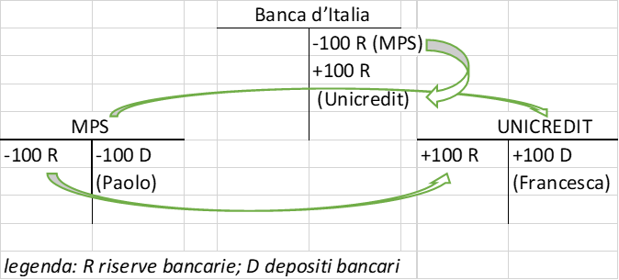
Payment system

Slide 4
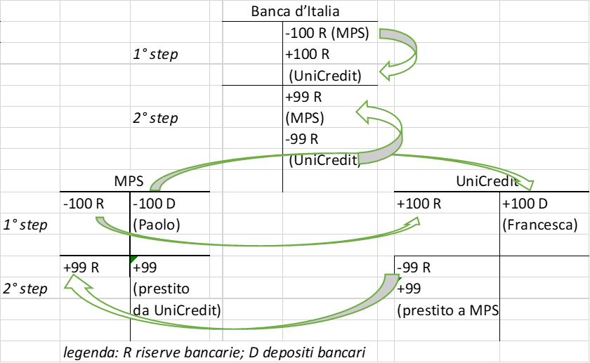
The interbank monetary market (the market for reserves)

Slide 5
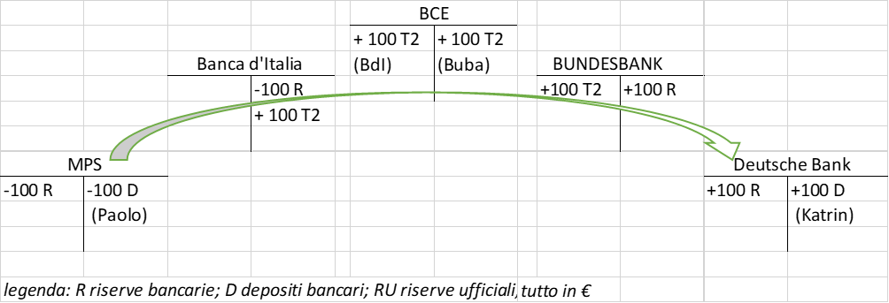
The (in)famous TARGET2

Slide 6
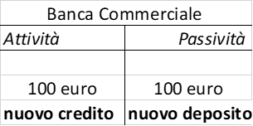
How banks create credit

Slide 7
Do banks need reserves to lend?
Even in monetary regimes where banks are obliged to hold reserve requirements as a share of deposits, they are not obliged to comply with the reserve requirement moment by moment, but on average by reference to the amount of deposits held in the previous "maintenance period".
In the Eurosystem the maintenance period consists of six weeks - the weeks between two meetings of the Governing Council of the ECB.
A bank is required to hold an average of 1% in reserves during the current maintenance period related to the deposits held in the previous "maintenance period".
They have time to collect reserves through the weekly CB’s main or longer term refinancing operations (or borrowing them from other banks with excess of reserves).
Endogenous money: credit→ deposits→reserves

Slide 8
Do banks need savings (deposits) to lend? (Loanable fund theory)
Exogenous money theory:
Reserves → Deposits → Credit
Monetary (deposit) multiplier
Banks lend excess reserves (impossible!)
Other tenets of traditional (marginal )theory:
Banks intermediate savings
Natural interest rate: the rate at which full capacity savings are equal to investment (Say’s Law).
The CB controls the interest rate, aiming at i_{m} = i_{n} by changing the money supply.
How all these propositions stay together is not clear. In simple terms: if the CB wants to decrease i, it offers more reserves (or decreases the required reserve coefficient), so banks lower the interest rate on credit to expand loans.

Slide 9
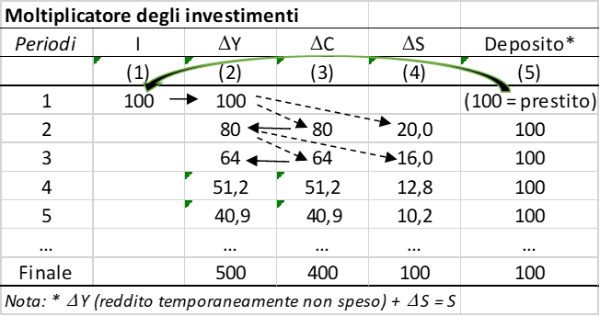
Endogenous money theory more consistent with Keynesian relationship between savings and investment

Slide 10
The Central Bank menu

Slide 11
The corridor
Central banks target the interest rate (the monetarist target of the money supply was a hangover in the 1970s/80s that only created confusion)
The corridor:
Marginal lending facility (discount windows) 5,0 %
Main refinancing operations (policy rate ) 4,0 %
Marginal deposit facility (excess reserves) 3,0 %
(tassi effettivi dal 13 gennaio 2007)
Recall: credit-->deposits→ reserves
The CB has to satisfy the demand for reserves at its policy rate. If it doesn’t, the overnight interest rate (EONIA in the Eurozone) would rise to the ceiling or fall to the floor.

Slide 12
Monetary policy in a nutshell
The central bank is price maker and quantity taker (i is exogenous, reserves are endogenous).
Because interbank payment flows (see above) there are always banks with excess R and banks with deficit of R.
Normally (trust) they exchange them and the overnight interbank monetary market rate gravitates around the policy rate:

Slide 13
The central bank is price maker and quantity taker
You have to appreciate that the CB cannot change the money supply at will: if it did, the interest rate would fluctuate.
This shows that the textbook view of monetary policy is wrong (as is Poole's 1971 model, if you know it).
With the GFC, CBs adopted the balance sheet policy, which implies the so-called floor system.
With the expansion of the money supply (quantitative easing) the interbank rate is squeezed to the floor.
In the floor system policy rate = deposit facility rate.

Slide 14
ECB de facto floor system

Slide 15
Balance sheet in normal times
Consolidated balance sheet of the Eurosystem (€ billion) (29 June 2007)
Assets |  |  | Liabilities
Autonomous liquidity factors | 449 | 730 | Autonomous liquidity factors
(assets) |  |  | (liabilities)
Net foreign assets | 318 | 633 | Banknotes
(Gold and other foreign assets) |  | 70 | Government deposits
Domestic assets | 131 | 27 | Other autonomous factors (net)
Monetary policy instruments | 464 | 183 | Monetary policy instruments
Main refinancing operations (MRO) | 313 | 182 | Current accounts (reserves)
Longer term refinancing | 150
operations (LTRO)
Marginal lending facility | 1 | 1 | Deposit faciity
Total | 913 | 913

Slide 16
Balance sheet in normal times
Right side: origin of liquidity
Left side: where liquidity stays
(730 + 183) – 449 = net liquidity deficit = 464
Monetary policy instruments = NLD = 464
Consolidated balance sheet of the Eurosystem (€ billion) (29 June 2007)
Assets |  |  | Liabilities
Autonomous liquidity factors | 449 | 730 | Autonomous liquidity factors
(assets) |  |  | (liabilities)
Net foreign assets | 318 | 633 | Banknotes
(Gold and other foreign assets) |  | 70 | Government deposits
Domestic assets | 131 | 27 | Other autonomous factors (net)
Monetary policy instruments | 464 | 183 | Monetary policy instruments
Main refinancing operations (MRO) | 313 | 182 | Current accounts (reserves)
Longer term refinancing | 150
operations (LTRO)
Marginal lending facility | 1 | 1 | Deposit faciity
Total | 913 | 913

Slide 17
Balance sheet in abnormal times
Consolidated balance sheet of the Eurosystem (€ billion) (3 May 2019 )
Assets |  |  | Liabilities
Autonomous liquidity factors | 947 | 2258 | Autonomous liquidity factors
(assets) |  |  | (liabilities)
Net foreign assets | 690 | 1229 | Banknotes
(Gold and other foreign assets) |  | 203 | Government deposits
Domestic assets | 257 | 826 | Other autonomous factors (net)
Monetary policy instruments | 3349 | 2038 | Monetary policy instruments
Main refinancing operations (MRO) | 6 | 1404 | Current accounts (reserves)
Longer term refinancing | 719 | 0 | Absorbing operations related
operations (LTRO) |  |  | to Security Market Programme
Securities held for monetary
policy purposes (mainly QE) | 2624
Marginal lending facility | 0 | 634 | Deposit faciity
Total | 4296 | 4296

Slide 18
Implications
My first aim has been to show you how wrong there is with monetary policy as it is (still) taught.But there are important implications for macroeconomic theory.
First, the endogeneity of money can be and is shared by even the best maninstream economists and central bankers. What differentiates mainstream and KP is not the edogenity of money (a fact), but the existence of the natural rate of interest (critical importance of capital theory in demolishing this concept).
Keynes flirted with endogenous money theory, but in GT he adopted an endogenous view (transited in textbooks).
In the famous articles of 1937 he partly retraced his steps by asking who financed investments (since he rejected the Loanable funds theory). Initial and final finance.
Financing through endogenous money creation (out of thin air) can also be extended from investment to other autonomous components of demand that in the Keynesian multiplier and in the supermultiplier (which we shall see) determine, respectively, the degree of utilisation of productive capacity and its growth rate.

Slide 19
Endogenous money and the autonomous non-capacity creating component of AD
Autonomous consumption financed by consumer credit. Credit (initial finance) → C_{A} → Y → S (final finance)
Saving = dissaving (no net saving)
Government spending: the State spends before taxing or collecting savings. MMT.
Analysis that merits further study given the formal prohibition of CBs to finance government spending.
Exports: vendor finance
International K flows: neoclassical thesis: capital rich countries lend excess saving to capital poor countries (International loanable fund theory).
In the endogenous money view, domestic or foreign banks in peripheral countries create credit in favour of peripheral countries (initial finance); this leads to CA deficits and, ex post, to loans from core countries (final finance)

Slide 20
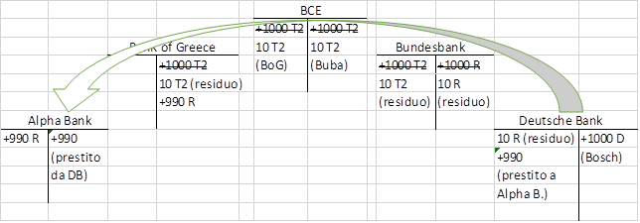
The European case

