Slide 1
Summing up 2nd lecture

Slide 2
Harrod-Domar
Keynesian hypothesis: independence of I from S from the short to the log run
Harrod-Domar model: unique equilibrium growth path
gw = s/vn
where vn = K/Y; gw unknown to entepreneurs (planning); unstable; no full-employment (neoclassical economists).
Instability: if ge > gw, then ga>ge.
Degree of capacity utilization: full, normal, actual
if ge > gw, then ga>ge, then ua>un.
If ua > un then va < vn
(if capacity is over utilized, capitalists have less capital per unit of product than they normally wish).

Slide 3
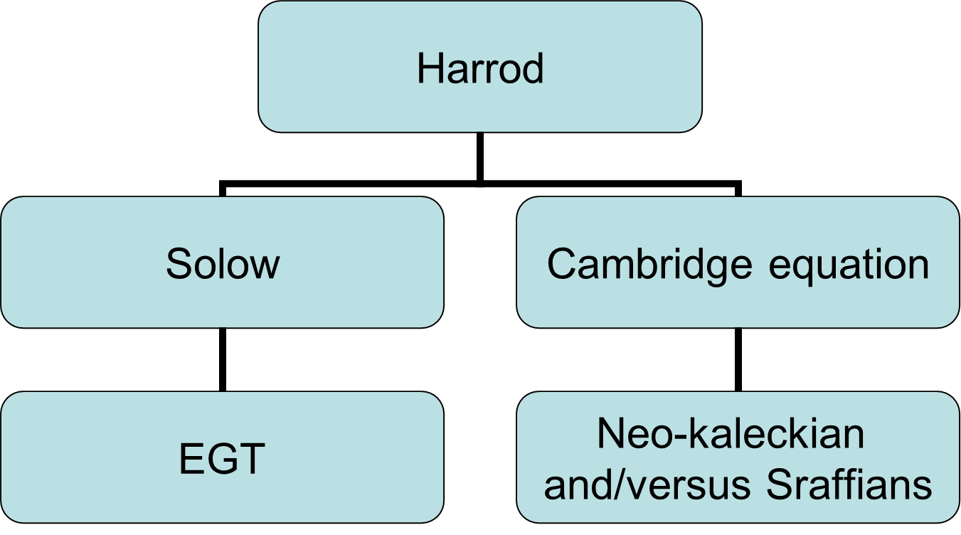
Two exit routes from gw = s/vn
If ga ≠ gw, either
ga → gw or gw → ga.
If, e.g., ga > gw, then
s/va > s/vn,
Either va will have to rise (neoclassical theory [and neo-kaleckians]),
or s will have to rise (Cambridge equation)

Slide 4
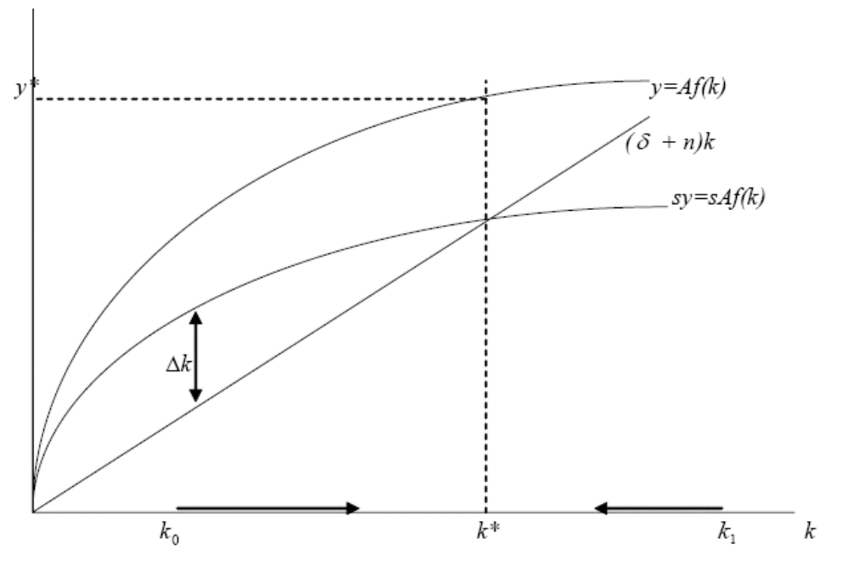
Solow’s exit
At k*, sy = nk, that is n = s/(y/k) = s/v = gw
If ga > gw, then
s/va > s/vn, va will rise.
Recall that v = K/Y=k/y
v will since both k and y rise, but y less (marginal decreasing returns), so
va --> vn
and ga --> gw

Slide 5
Problems
Problems:
- result of the capital theory controversy (if i falls, k may rise or fall).
- If s rises, k and y will rise, but not gw (= n): level but not growth effect
- Neoclassical economists got gw = n but lost s → g (as in H-D).
Endogenous growth theory (all ad hokery)
We shall now explore the heterodox attempts to solve H-D’s troubles.

