Slide 1
A bank plenty of half truths: ignorance, bad faith or what?
Sergio Cesaratto
DEPS
Cesaratto@unisi.it

Slide 2
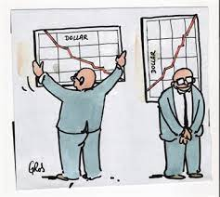
First of all, let us call things by their proper name
The Sveriges Riksbank Prize in Economic Sciences in Memory of Alfred Nobel
The ‘Nobel prize’ that isn’t https://mondediplo.com/2005/02/12nobel

Slide 3
From https://www.nobelprize.org/prizes/economic-sciences/2022/press-release/
“Bernanke showed that its main cause [of the GFC] was the decline in the banking system’s ability to channel savings into productive investments”.
“To understand why a banking crisis can have such enormous consequences for society, we need to know what banks actually do: they receive money from people making deposits and channel it to borrowers”
“Diamond and Dybvig developed theoretical models that explain why banks exist”
“Banks create money” WOW! But, which is the right proposition?

Slide 4
In one state of mind the Sveriges Riksbank somehow admits that banks create bank money (deposits) when granting loans, but in a confused way.
“Diamond and Dybvig show that this process is how banks create liquidity. The money in the depositors’ accounts is a liability for the bank, while the bank’s assets consist of loans to long-term projects. The bank’s assets have a long maturity, because it promises borrowers that they will not need to pay back their loans early. On the other hand, the bank’s liabilities have a short maturity; depositors can access their money whenever they want. The bank is an intermediary that transforms assets with long maturity into bank accounts with short maturity. This is usually called maturity transformation.”
Note the ambiguity: when banks create a deposit, the deposit holder and loan holder are the same person: the bank is intermediating anything,
Only ex post, when the borrower has spent the deposit and, through the Keynesian multiplier, investment has generate new savings, one can say that the deposit consist of saving and that the bank is intermediating saving and transforming maturity.
A nuance? You decide.
It is strange that the great Swedish marginalists Wicksell and Ohlin well understood this!

Slide 5
In another state of mind the Sveriges Riksbank maintains that banks generates money creating deposits in favour of savers and then lend: but which assets savers bring to the bank?
“we need to know what banks actually do: they receive money from people making deposits and channel it to borrowers”.
Deposits in the first instance are not created “out of thin air” in favour of savers, but of borrowers that use them for payments.
How could banks create deposits in favour of savers? In exchange of what? There are only two hypotheses: savers deposit corn (after all neoclassical economics works only in a only-corn-world), or deposit deposits. But then savers must already have deposits (and how have they been created?) The two hypotheses in the next two slides.

Slide 6
Jakob & Kumhof (WP BoE 2015) make fun of the traditional view of banks as intermediaries of saving, what would work only in a gravel economy

Slide 7
The other hypothesis is that of the Sveriges Riksbank in which banks collect saving (deposits) and lend them “we need to know what banks actually do: they receive money from people making deposits and channel it to borrowers”. But what savers deposit in the bank: banknotes? and how they got them. Deposits? But if bank A uses a new deposit to grant a loan, bank B has lost a deposit and reduced loans. This is ridiculous!

Slide 8
The Sveriges Riksbank is clearly in a confused state of mind (or in mala fide): a third state of mind
“Savers can use their deposit accounts for direct payments. The bank has thus created money, not from thin air but from the long-term investment projects to which it has lent money. Banks are sometimes criticised for creating money, but here we see that this is precisely why they exist.”
In this further of its states of mind, the Sveriges Riksbank admits that banks create deposits by generating loans (admitting part of the heterodox argument) but not out of the thin air since they are backed by the investment they finance. But this investment is only a project (thin air). Credit also finance consumption (thin air) and speculative bubbles (thin air). Banks are dangerous and must be surveilled precisely because they can produce thin air out of thin air.
Supporters of the Chicago plan (100% reserves), like Kumhof, move in fact from the capacity of banks to create loans out of thin air.

Slide 9
The endogeneity of money is a fact and it is thus shared by serious economists both mainstream and PK.
Other mainstream economists at the BoI, BoE, Bundesbank, BIS etc. are less ambiguous on the role of banks and endorse endogenous money theory. Ulrich Bindseil acknowledges the path breaking role of PK economists in this regard.
Indeed the differentia specifica between serious mainstream and PK economists does not regard the role of banks and the endogeneity of money, but the natural interest rate. In neoclassical theory banks lend out of thin air, but they should do it at the natural interest rate, so it is as if they were virtually lending full-employment savings.
For PK economists the natural interest rate is a fake, especially after the Cambridge controversy on the theory of capital.

Slide 10
The Sveriges Riksbank’s motivations to award these “Nobel” prices rise other perplexities
Bernanke: “A rumour [sic] may start, saying that more savers than the bank can cope with are about to withdraw their money. Regardless of whether this rumour is true, it can send depositors rushing to the bank to withdraw their money in case the bank goes bankrupt. A bank run ensues.” What a poor theory of financial crises!
Diamond: “the risk that a major bank will collapse due to this is small, as long as the bank manages its lending activities in a responsible manner. This is because a bank grants loans to a large number of borrowers. Even if a few borrowers default on their loans, the losses across all loans will be small and predictable”. Mmmmm, it sounds the theory that backed securitization of mortgages and caused the 2008 financial crisis in the US!

Slide 11
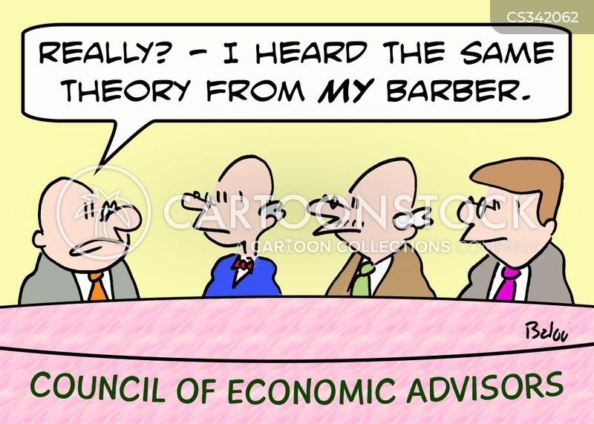
I’m too busy with the next model, no time for nuances
What I am afraid of is that for most mainstream economists (or those borderline but prudently in the safer side) these are all theoretical nuances; instead, if taken seriously, they would change your mind and are not annoying nuances
Secondly I am worried that wrong theories are still taught in university courses. The monetary multiplier is a fake (ask Bindseil). Another workhorse of mainstream monetary policy (Pool 1970) is a fake (ask Bindseil, not Blanchard who believes in it). The question is that monetary policy can be rigorously explained only starting from the endogeneity of money (ask Claudio Borio at BIS).
Thanks!
PS slides available in my web page
“materiali”

Slide 12
References
Jakab, Zoltan and Kumhof, Michael, Banks are Not Intermediaries of Loanable Funds – And Why This Matters (May 29, 2015). Bank of England Working Paper No. 529, Available at SSRN: https://ssrn.com/abstract=2612050 or http://dx.doi.org/10.2139/ssrn.2612050
https://www.nobelprize.org/prizes/economic-sciences/2022/press-release/
Peter Bofinger https://socialeurope.eu/a-noble-award-for-a-popular-misconception
Cesaratto, S. (2021) Sei lezioni sulla moneta- La politica monetaria com’è e come viene raccontata, Diarkos, Reggio Emilia [full of references to Ulrich Bindseil and Claudio Borio and many other serious mainstreams]

