Slide 1
G&D 2024-25
Introductory lecture
A long run overview over economic growth. Some topics
Cesaratto@unisi.it

Slide 4
Topic: causes of the agricultural revolution (or neolithic evolution); where it took place?
Domestication of plants and animals 10 000 y BC
Causes adoption agriculture (from Hunter-Gatherers nomadic population to sedentary populations)
Climate change. Global warming (end of one small ice age). Shara became desert.
Population pressure: need for increased food supplies and depletion of natural, free resources (tragedy of commons: overexploitation). Criticism: HG could controll fertility (abortion, infanticide, delayed marriage…)
Where the neolithic revolution took place? Jared Diamond: geographical/material explanation (edible plants, domesticable plants and animals)
Suggested reading: Svizzero & Tisdell

Slide 5
Topic: Standards of life before and after the neolithic revolution
With the agricoltural revolution:
Epidemies (from domestic animals)
More effort for lower results in terms of diet (methaphor of the Paradise lost). Lower healt and physical strength
Cases of reversals to HG
It seems that the early farmers were still egalitarian (household production)
How HG or early rural populations preserved equality? And then, how stratification emerged?
Classical reading: Sahlins

Slide 6
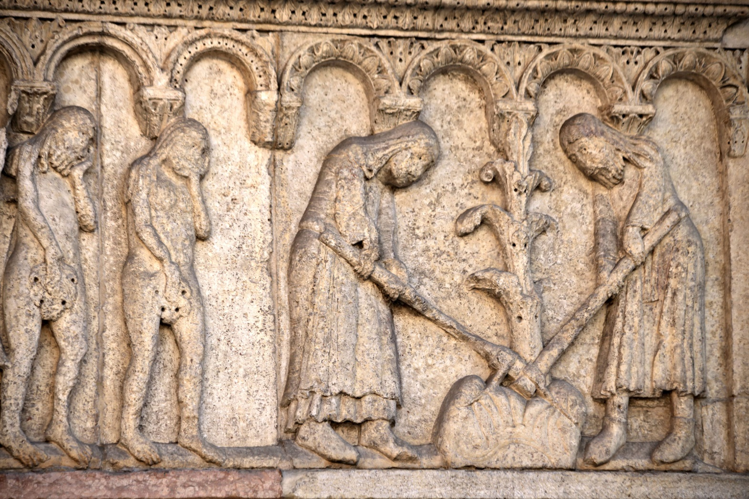
Expulsion from Paradise on earth and the adoption of agriculture

Slide 7
Topic: the origins of inequality
So while at some point inequality emerged? Many theories
Economic Surplus→ Surplus = Social product – workers’ subsistences - replacements
Mechanistic explanation of the onset of inequality: potential surplus is appropriated by an élite that takes the political power
More sophisticated theories
Storage: Production of the basic commodity (corn/grain) involves storage, and this can be done communally; management is entrusted to persons (such as priests) of common trust; slowly they take control. Management implies accounting, hence invention of numbers, writing, forms of cupons. This gives rise to a distributive state centred on city nuclei (The palace--> Palatial economy) --> history more or less appplicable to Mesopotamia and later Mycenaean Greece.
Suggested reading: Scott (2017), a much discussed book is Graeber and Wengrow (2021)

Slide 8
Topic: The urban revolution (V.G. Childe). Mesopotamia
Other or complementary hypothesis: 5000 BCE irrigation (collective effort→ implies a State, hydraulic hypothesis) (does this remind you of a particular state in this regard?)
4500 invention of the plough → some larger household with some accumulated wealth could invest in ox-driven plough (oxen are costly to rise and maintain)
Economic Surplus→ Surplus = Social product – workers’ subsistences - replacements → towns and social stratification
Tributary state. Relation town-country
Also slavery (common especially in Greece and Rome) implies that that slaves are employed in activities producing a surplus (typically by Romans in the Italian Villas), or if used as servants, a surplus must be produced elsewhere.

Slide 9
Maddison 0-1998. Low growth of GDP percapita and of population. Why? Topic: Malthusian trap: higher growth conducive to population growth and stagnating GDP per capita (GDP/POP). Only with the industrial revolution g(GDP) > g(POP) →g(GDPpc)>0

Slide 10
Topic: growth in ancient economies
Malthusian Hypothesis apart, in the 1970s and 1980s the view of Moses Finlay (Cambridge) was dominant in economic history: the ancient societies (Rgreek and Roman in particular) were qualitatively different from modern economies.
Small élites lived out of a surplus produced by the population majority which lived at a subsistence level. The élites were disinterested of economic growth (but rather concerned with politics, war, art etc).
The surplus was also used for conspicuous, ostensive consumption to gain the admiration of the population (this include tombs etc.); or partially redistributed through festivals (this is a general point appliable even to modern societies: Theodore Veblen or Old Institutional Economics) →Vanity Fair.
New Institutional Economics (Douglass North) now dominant in economic history argues that there was growth in Classic Greece and in Rome due to good institutions favourable to commerce and individual initiative (this is a general point made by NIE: institutions matter to favour growth; Acemoglu and Robinson 2012 call extractive those institution that exploit the population and inclusive those that favour individual initiative. NIE is a branch of neoclassical economics.

Slide 11
More recent times(from Meddison)

Slide 12
The evolution of world geopolitics

Slide 13
The golden age (Keynesian era) and the neoliberal order

Slide 14
Three other phases
Great moderation & globalization (1990s until the Second Great Financial Crisis 2008)
2008-2020 GFC + Pandemic
2021 recovery
After 2022: geopolitical tensions, de-globalization.
An uncertain future (particularly for the EU)

Slide 16
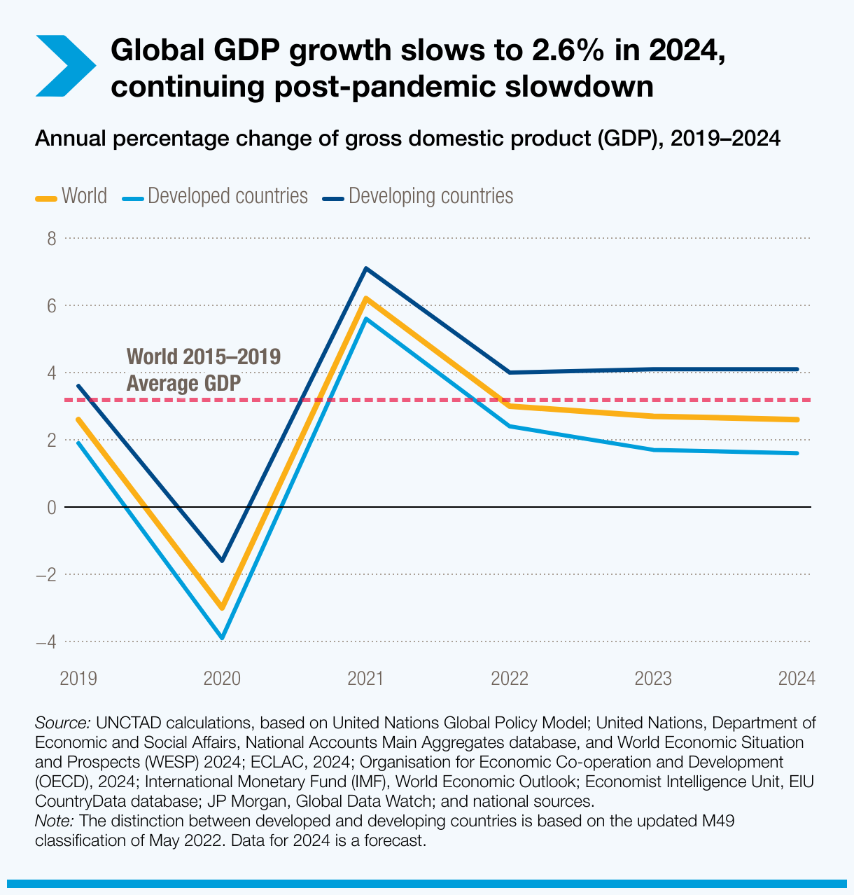

Slide 17
References (intended for for those who wish to pursue a topic)
S. Cesaratto, Heterodox Challenges pp. 13-17 (mandatory)
Svizzero, S. & Tisdell, C., 2014. Theories about the Commencement of Agriculture in Prehistoric Societies: A Critical Evaluation, WP School of Economics, the University of Queensland, no. 68.
Sahlins M. 1972, Stone Age Economics, Chicago: Aldine Publishing.
Scott, J.C. (2017). Against the Grain:A Deep History of the Earliest States. Yale University Press, New Haven.
Graeber, David and Wengrow, David 2021. The Dawn of Everything. A New History of Humanity. New York: Farrar, Straus and Giroux.
Acemoglu D. and Robinson J.A. 2012, Why Nations Fail: The Origins of Power, Prosperity and Poverty, Profile, New York: Crown.
https://unctad.org/publication/trade-and-development-report-2023
(2024 edition forthcoming)

