Slide 1
G&D 2024-25
Endogenous money, monetary policy and demand-led growth
Sergio Cesaratto
sergio.cesaratto@unisi.it

Slide 2
Oversimplified balance sheet of a commercial bank

Slide 3
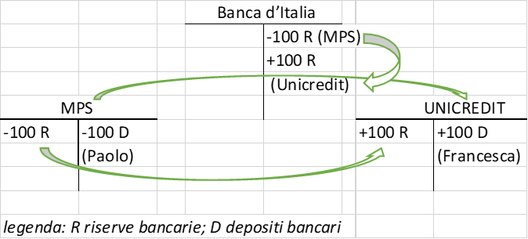
Payment system

Slide 4
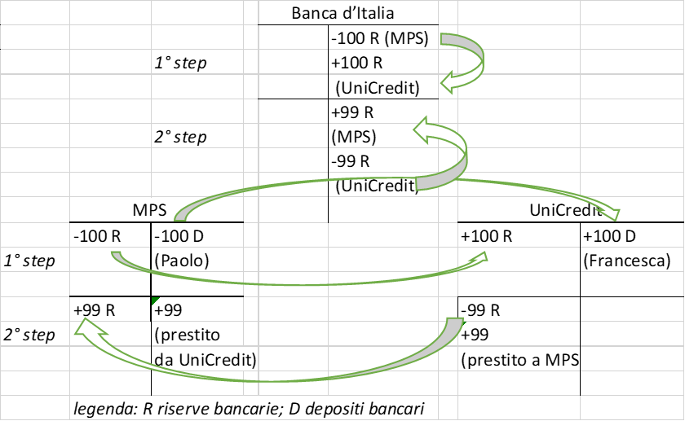
The interbank monetary market (the market for reserves)

Slide 5
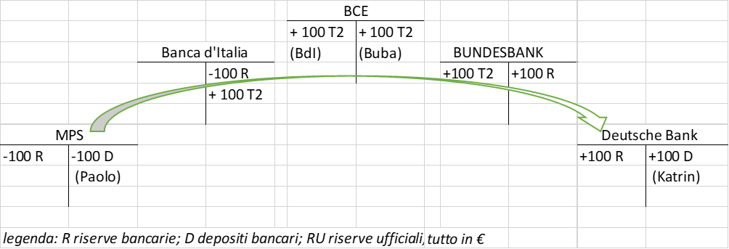
The (in)famous TARGET2

Slide 6
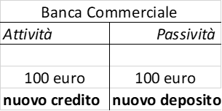
How banks create credit

Slide 7
Do banks need reserves to lend?
Even in monetary regimes where banks are obliged to hold reserve requirements as a share of deposits, they are not obliged to comply with the reserve requirement moment by moment, but on average by reference to the amount of deposits held in the previous "maintenance period".
In the Eurosystem the maintenance period consists of six weeks - the weeks between two meetings of the Governing Council of the ECB.
A bank is required to hold an average of 1% in reserves during the current maintenance period related to the deposits held in the previous "maintenance period".
They have time to collect reserves through the weekly CB’s main or longer term refinancing operations (or borrowing them from other banks with excess of reserves).
Endogenous money: credit→ deposits→reserves

Slide 8
Do banks need savings (deposits) to lend? (Loanable fund theory)
Exogenous money theory: Reserves → Deposits → Credit
Monetary (deposit) multiplier (R → D →L) → discredited
It is sometimes even said that banks extend loans when they have excess reserves (impossible!)
Other tenets of traditional (marginal )theory:
Banks intermediate savings (LFT)→ discredited. A modern marginalist would accept that L→D→R
The important thing is that L(in), that is in equilibrium loans are granted at the natural interest rate: the rate at which monetary loans are equal to full capacity savings are equal to investment (Say’s Law).
They thus admit a ‘Keynesian’ sequence L(in) → I(in) → capacity savings (implicit critique to Garegnani: even Keynes’ multiplier is absorbable by marginalists; the key difference is between I(in) and I(expected demand)
The CB controls the interest rate, aiming at i_{m} = i_{n} by changing the money supply.
In simple terms: if the CB wants to decrease i, it offers more reserves with an open market operation (or decreases the required reserve coefficient), so banks lower the interest rate on credit and at the same time use the extra-reserves to expand loans.

Slide 9
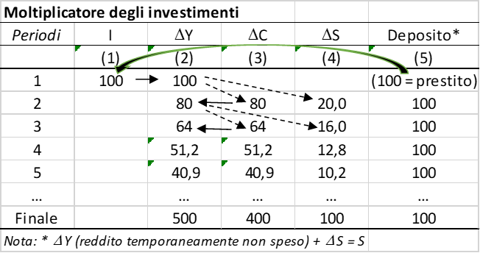
Endogenous money theory more consistent with Keynesian relationship between savings and investment (but as long as I(in) this could be accepted by a clever marginalist) initial finance final finance or funding

Slide 10
Please note that…
Ex ante: new bank liquidity → net investment → additional saving
Ex post: deposits = stock of savings = capital stock
All this is acceptable by mainstreamers (although few are so clever to know this and they stick to the loanable fund theory, monetary multiplier, etc). However endogenous money theory doesn’t play an essential role as in PK theory.
Let us go to monetary policy. This is also different from mainstream textbooks (that often reflect Keynes’s liquidity preference theory which is perfectly consistent with neoclassical theory, as seen).

Slide 11
The Central Bank menu

Slide 12
The classical corridor (e.g. ECB 1999-2008)
Central banks target the interest rate (the monetarist target of the money supply was a hangover in the 1970s/80s that only created confusion)
The classical corridor:
Marginal lending facility (discount windows) 5,0 %
Main refinancing operations (policy rate ) 4,0 %
Marginal deposit facility (excess reserves) 3,0 %
rates at 13 January 2007)
Presently 4%, 4.5%, 5% but we are not in a classical corridor, as we shall see. But to understand the present system, it is useful to understand first the corridor.
Recall: credit-->deposits→ reserves
The CB has to satisfy the demand for reserves at its policy rate. If it doesn’t, the overnight interest rate/operative target (EONIA in the Eurozone) would rise to the ceiling or fall to the floor.

Slide 13
Monetary policy in a nutshell
The central bank is price maker and quantity taker (i is exogenous, reserves are endogenous).
Because the CB keeps the reserve supply precisely in line with the reserve requirement of banks (scarce reserve regime), there are always, symmetrically, banks with excess R and banks with deficit of R.
When confidence (mutual trust) banks exchange reserves and the overnight interbank monetary market rate gravitates around the policy rate:

Slide 14
The central bank is price maker and quantity taker
You have to appreciate that the CB cannot change the money supply at will: if it did, the interest rate would fluctuate.
This shows that the textbook view of monetary policy is wrong (as is Poole's 1971 model, if you know it).
With the GFC, CBs adopted the balance sheet policy, which implies the so-called floor system.
With the expansion of the money supply (through longer term refinancing operations and quantitative easing) the interbank rate is squeezed to the floor.
LTRO (collateralized loans granted for 3 or 4 years) the initiative is on the banks; with QE [APP 2015, PEPP 2020) the initiative is on the ECB.
With abundant liquidity we transit to a floor system in which policy rate = deposit facility rate. The Euro area is in a FS (or ample reserve regime) since 2015 at least, but this has been ufficialized only last March!

Slide 17
Balance sheet in normal times
Consolidated balance sheet of the Eurosystem (€ billion) (29 June 2007)
Assets |  |  | Liabilities
Autonomous liquidity factors | 449 | 730 | Autonomous liquidity factors
(assets) |  |  | (liabilities)
Net foreign assets | 318 | 633 | Banknotes
(Gold and other foreign assets) |  | 70 | Government deposits
Domestic assets | 131 | 27 | Other autonomous factors (net)
Monetary policy instruments | 464 | 183 | Monetary policy instruments
Main refinancing operations (MRO) | 313 | 182 | Current accounts (reserves)
Longer term refinancing | 150
operations (LTRO)
Marginal lending facility | 1 | 1 | Deposit faciity
Total | 913 | 913

Slide 18
Balance sheet in normal times
Right side: origin of liquidity
Left side: where liquidity stays
(730 + 183) – 449 = net liquidity deficit = 464
Monetary policy instruments = NLD = 464
Consolidated balance sheet of the Eurosystem (€ billion) (29 June 2007)
Assets |  |  | Liabilities
Autonomous liquidity factors | 449 | 730 | Autonomous liquidity factors
(assets) |  |  | (liabilities)
Net foreign assets | 318 | 633 | Banknotes
(Gold and other foreign assets) |  | 70 | Government deposits
Domestic assets | 131 | 27 | Other autonomous factors (net)
Monetary policy instruments | 464 | 183 | Monetary policy instruments
Main refinancing operations (MRO) | 313 | 182 | Current accounts (reserves)
Longer term refinancing | 150
operations (LTRO)
Marginal lending facility | 1 | 1 | Deposit faciity
Total | 913 | 913

Slide 19
Balance sheet in abnormal times
Consolidated balance sheet of the Eurosystem (€ billion) (3 May 2019 )
Assets |  |  | Liabilities
Autonomous liquidity factors | 947 | 2258 | Autonomous liquidity factors
(assets) |  |  | (liabilities)
Net foreign assets | 690 | 1229 | Banknotes
(Gold and other foreign assets) |  | 203 | Government deposits
Domestic assets | 257 | 826 | Other autonomous factors (net)
Monetary policy instruments | 3349 | 2038 | Monetary policy instruments
Main refinancing operations (MRO) | 6 | 1404 | Current accounts (reserves)
Longer term refinancing | 719 | 0 | Absorbing operations related
operations (LTRO) |  |  | to Security Market Programme
Securities held for monetary
policy purposes (mainly QE) | 2624
Marginal lending facility | 0 | 634 | Deposit faciity
Total | 4296 | 4296

Slide 20
Present debates on monetary policy implementation
CBs are engaged in a quantitative tightening (problematic in the EMU)
A return to the scarce reserve regime (the corridor)?
Banks used to ample reserves (still lack of trust; loss of financial skill to live with scarce reserves; reserves as safe asset for financial regulation, often obtained by CBs for less prised assets). Experience of the Fed in Sept. 2019.
FED officially opted for a supply driven floor system: the CB estimates reserve demand and offers them with a safety margin
ECB (BoE earlier) demand driven floor system: banks are left to decide the amount of reserves they wish (reserves are allocated through repos with a fixed rate full allotment method)
Now banks have still a lot of reserves that, however, will fall with QT. Therefore the ECB will provide in the future also new forms of LTRO so to provide a more lasting base of liquidity.

Slide 21
Polemics
The floor system can be costly: excess reserves are held in the deposit facility (if held in the CC are not remunerated) it was free of costs when iDF was negative, but with inflation from 2022 the corridor is in positive territory.
De Grauwe and others proposed to increase the mandatory reserve coefficient (now at 1% of deposits) with a zero remuneration for RR.
Problem: mal distribution of excess reserves in the euro area. Italy and Soain would be short of reserves.
Are BdI and BdE subsidising German banks? (the costs of the DF are pooled and redistributed in the Eurosystem). A very complicated issue since other items are pooled, I am trying to understand what is going on.

Slide 22
More theoretical implications of my lectures
My first aim has been to show you how wrong there is with monetary policy as it is (still) taught. But there are important implications for macroeconomic theory.
First, the endogeneity of money can be and is shared even by the best mainstream economists and central bankers. What differentiates mainstream and PK is not the endogenity of money (a fact), but the existence of the natural rate of interest (critical importance of capital theory in demolishing this concept).
In the PK-Endogenous money view the nominal interest rate is entirely a creature of the central bank (the real interest rate depends on conflict over income distribution, Stirati 2003)
Keynes flirted with endogenous money theory, but in General Theory he adopted an exogenous view (transited in textbooks).
In the famous articles of 1937 he partly retraced his steps by asking who financed investments (since he rejected the Loanable funds theory). Initial and final finance. (see Cesaratto and Pariboni 2022)
Financing through endogenous money creation (out of thin air) can also be extended from investment to other autonomous components of demand that in the Keynesian multiplier and in the supermultiplier determine, respectively, the degree of utilisation of productive capacity and its growth rate. See Cesaratto and Di Bucchiaico 2021

Slide 23
Endogenous money and the autonomous non-capacity creating component of AD
Autonomous consumption financed by consumer credit. Credit (initial finance) → C_{A} → Y → S (final finance). Saving = dissaving (no net saving)
Government spending: the State spends before taxing or collecting savings. MMT.
Analysis that merits further study given the formal prohibition of CBs to finance government spending.
Exports: vendor finance
International K flows: neoclassical thesis: capital rich countries lend excess saving to capital poor countries (International loanable fund theory).
In the endogenous money view, domestic or foreign banks in peripheral countries create credit in favour of peripheral countries (initial finance); this leads to CA deficits and, ex post, to loans from core countries (final finance)

Slide 24

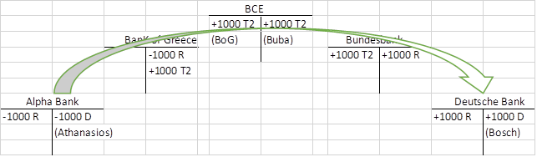
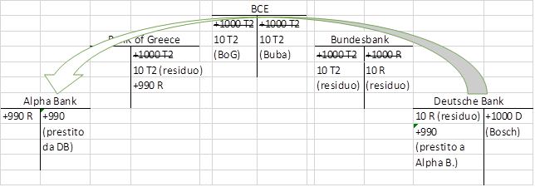
The European case

Slide 25
References I
Cesaratto, S. (2021) Sei lezioni sulla moneta- La politica monetaria com’è e come viene raccontata, Diarkos, Reggio Emilia.
Cesaratto, S., & R. Pariboni (2021) Keynes’s finance, the monetary and demand-led circuits: a Sraffian assessment, WP DEPS n. 851. Review of Keynesian Economics, forthcoming
Cesaratto, S., & Di Bucchianico, S. (2020). Endogenous money and the theory of long period effective demand. Bulletin of Political Economy, 14(1).
Cesaratto, S. (2020), Heterodox Challenges in Economics – Theoretical Issues and the Crisis of the Eurozone, Springer http://www.springer.com/9783030544478
U. Bindseil, The Operational Target of Monetary Policy and the Rise and Fall of Reserve Position Doctrine, «ECB Working Paper», n. 372, 2004;
P. Disyatat, Monetary policy implementation: Misconceptions and their consequences, «BIS Working Papers», n. 269, 2008;
T. Fullwiler, Modern Central Bank Operations – The General Principles, in L. P. Rochon e S. Rossi, Advances in Endogenous Money Analysis, Edward Elgar, 2008.
On current issues

Slide 26
References II
On current issues:
S.Cesaratto, E.Febrero (2024) Annotazioni sull’implementazione della politica monetaria: ieri, oggi, domani , Moneta e Credito, V. 77 N. 306. (free download)
Schnabel, I. (2023) Back to normal? Balance sheet size and interest rate control Speech given at Columbia University, New York, 27 March 2023
Schnabel, I. (2023) The Eurosystem’s operational framework, Speech by Isabel Schnabel, Member of the Executive Board of the ECB, at the Money Market Contact Group meeting Frankfurt am Main, 14 March 2024
De Grauwe, Paul and Ji, Yuemei (2024) How to conduct monetary policies: the ECB in the past, present and future. Journal of International Money and Finance, 143.

