Slide 1
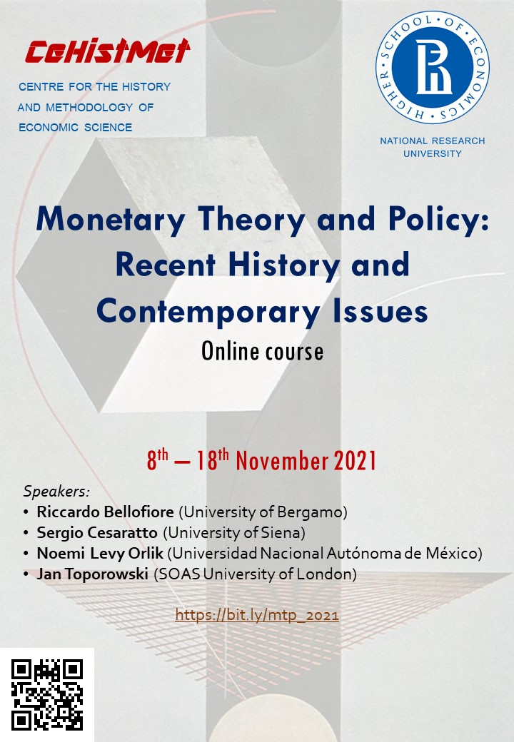

Monetary Theory and Policy

Slide 2
Sergio Cesaratto (Professor, University of Siena) https://docenti-deps.unisi.it/sergiocesaratto/
Cesaratto@unisi.it
Economia internazionale 2024-25

Slide 3
Lecture 1/2: Endogenous and exogenous money. Systems of payments
I will not engage in philosophical disquisitions on the nature or history of money, I prefer to move operationally to how money is created, lives and eventually dies.
Hierarchy of currencies.
Typically in an economic transaction the two parties use a currency issued by a superior body that both trust.
In principle, currency issued by one of the two parties in the form of a promise of payment (an I owe you) could be used in the exchange. This is sometimes the case between acquaintances or businesses between which there is trust.
However, it is difficult for an IOU to be used by the recipient for payments, although sometimes such an IOU, if particularly high quality, can be taken to a bank which 'discounts' it, i.e. advances its value.

Slide 4
Hierarchy of currencies
For these reasons, private individuals use banknotes (issued by the central bank) or bank money (deposits issued by commercial banks) in their transactions.
The commercial banks in turn use for transactions among themselves a particular currency issued by the central banks: bank reserves.
Central banks trade with each other using gold or international currencies, also called reserve currencies because they are a good asset to hold in official reserves.
While it is straightforward to understand how payments by banknotes work, it is less clear how bank deposits are created and circulated.
To this end, let us first briefly introduce a small balance sheet of a commercial bank.

Slide 5
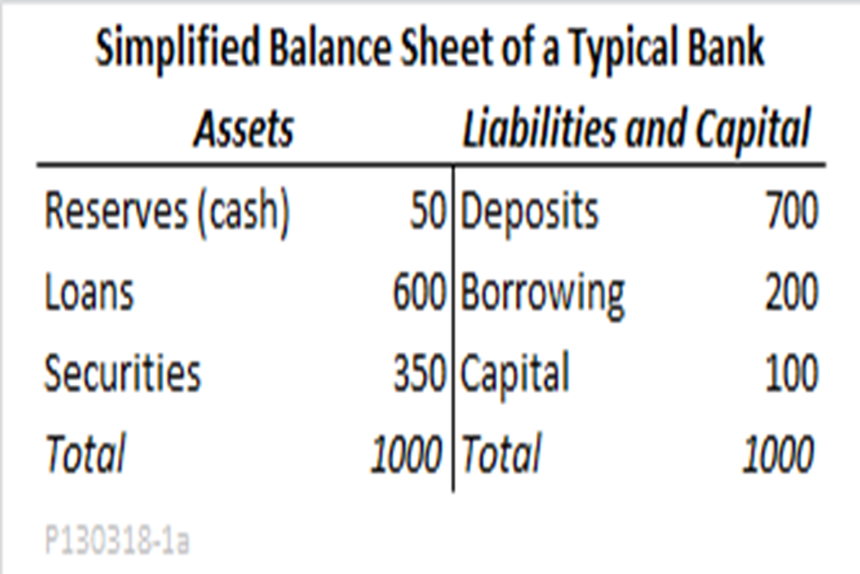
We note that deposits are a liability for the bank; loans are an asset; reserves are also an asset held in a current account at the central bank.

Slide 6
Interbank payments: Paolo makes a payment to Francesca

Slide 7
Banks need reserves to meet reserve requirements (1% of deposits in the EMU) and because they use them in payments. Thus, when banks trust each other, they exchange reserves in the interbank market: banks with excess reserves sell them overnight to banks with excess reserves.

Slide 8
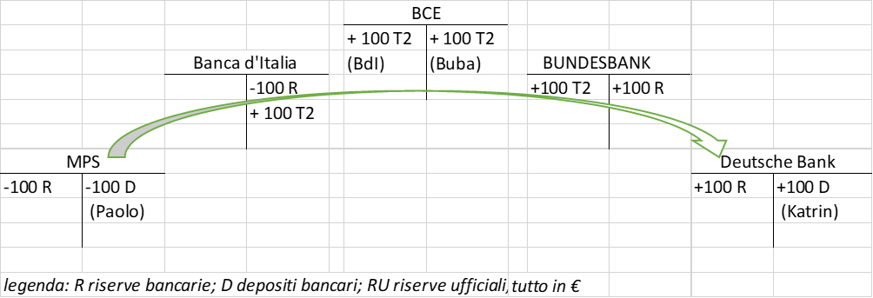
The (in)famous TARGET2: how payments work in the Eurosystem

Slide 9
How banks creates loans and deposits: loans generates deposits: The only proviso is that the client is reliable. This is the core of endogenous money theory

Slide 10
Do banks need reserves to lend?
Even in monetary regimes where banks are obliged to hold reserve requirements as a share of deposits, they are not obliged to comply with the reserve requirement moment by moment, but on average by reference to the amount of deposits held in the previous "maintenance period".
In the Eurosystem the maintenance period consists of six weeks - the weeks between two meetings of the Governing Council of the ECB.
A bank is required to hold an average of 1% in reserves during the current maintenance period related to the deposits held in the previous "maintenance period".
They have time to collect reserves through the weekly CB’s main or longer term refinancing operations (or borrowing them from other banks with excess of reserves).
We will also see that the central bank will never fail to provide the banks with the necessary reserves.
Endogenous money: credit→ deposits→reserves

Slide 11
How banknotes are generated?

Slide 12
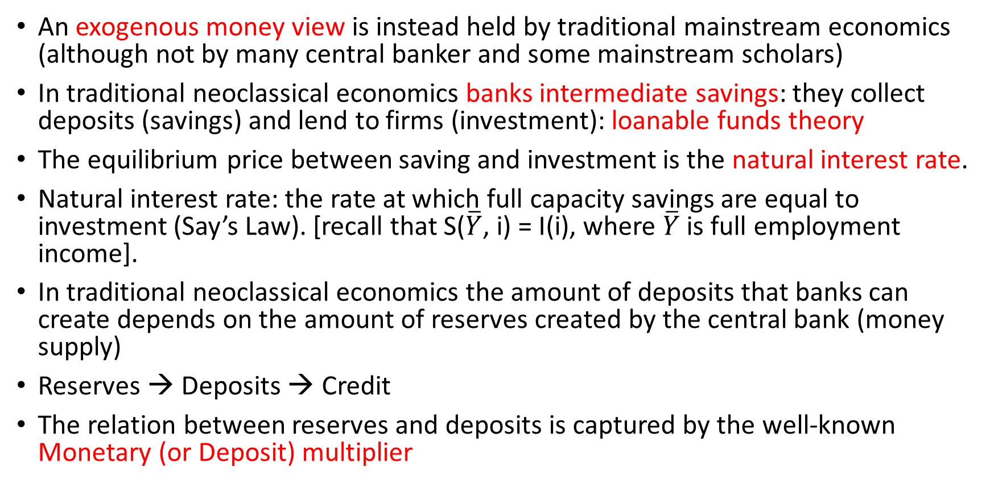
Endogenous money and mainstream economics
An exogenous money view is instead held by traditional mainstream economics (although not by many central banker and some mainstream scholars)
In traditional neoclassical economics banks intermediate savings: they collect deposits (savings) and lend to firms (investment): loanable funds theory
The equilibrium price between saving and investment is the natural interest rate.
Natural interest rate: the rate at which full capacity savings are equal to investment (Say’s Law). [recall that S($\overline{Y}$, i) = I(i), where $\overline{Y}$ is full employment income].
In traditional neoclassical economics the amount of deposits that banks can create depends on the amount of reserves created by the central bank (money supply)
Reserves → Deposits → Credit
The relation between reserves and deposits is captured by the well-known Monetary (or Deposit) multiplier

Slide 13
The deposit multiplier
As well known, γ is the reserve coefficient (mandatory reserves on deposits) and α if the share of money that the public wants to hold in banknotes (as a share of deposits). BM is base money (reserves +banknotes)
In this theory, when banks receive reserves, they lend them out, only retaining a share to meet reserve requirements.
It is true that even in this theory banks generate credit by creating deposits, but...
the process starts with the availability of reserves, and the demand for credit is a function of supply (a law of Say of credit).
Moreover, in this theory banks collect savings to finance investments.
It is also unsustainable to maintain that banks lend excess reserves. These circulates only in the current accounts bank hold at the central bank!

Slide 14
Summing up the neoclassical exogenous money view:
S → I, banks intermediate savings (deposits), reserves → deposits → credit
The idea is that central banks control the interest rate by, at the same time, manoeuvring the quantity of money.
E.g. they lower the interest rate by manipulating the money supply. A lower interest rate stimulates demand for credit, the supply of which, on the other hand, increases because the central bank has increased the supply of reserves, and this activates the monetary multiplier..
Note that monetary policy (the control of the interest rate) is based on changes in the money supply.

Slide 15
Real and monetary equilibria in neoclassical theory
The objective of monetary policy is that a "natural" interest rate prevails in the market at which on the one hand the supply of capacity savings is equal to the demand for investment, and on the other hand the supply of loanable funds is equal to the demand (the S/I market is the real expression of the loanable funds market, the links being the natural rate of interest)

Slide 16
Endogenous money theory more consistent with Keynesian relationship between savings and investment
In Keynes (and Kalecki) it is investment that determines saving through the Keynesian income multiplier.
But how are investment financed?
Here the endogenous money view provide the answer: through money creation by commercial banks.
Two examples

Slide 17
Keynesian income multiplier and endogenous money

Slide 18
We can also imagine that savers wish to hold part of their savings in securities (B), while in turn the investor issues securities to finance the investment on a longer term. In this way the investor returns at least part of the credit to the bank and the money initially created is thus destroyed.

Slide 19
Keynes and endogenous money
In the General Theory Keynes does not deal with the financing of investment and can be said to have an exogenous theory of money.
In fact, it can be said that his theory of liquidity preference forms the basis of the analysis of monetary policy found in textbooks.
In this theory the liquidity preference is the basis for the demand for money (inverse function of the interest rate); by controlling the money supply the central bank controls the interest rate.
Only in some famous essays after the GT Keynes introduces the problem of the financing of investments.

Slide 20
Lecture 3– Monetary policy: endogenous and exogenous monetary views
We have already mentioned the exogenous money version of monetary policy, which is Keynes': given the money demand function (preference for liquidity), the central bank decides on the money supply and thus determines the interest rate.
Monetary policy does not work as it is told in textbooks
We have seen how according to endogenous money theory:
credit-->deposits-->reserves
So let us start by looking at how the central bank generates the reserves demanded by the banks.
Just as a premise: according to the textbooks it is indifferent for the central bank to have as an operative target either the money supply or the interest rate; for us the operative target has always been the interest rate and this indifference is ill-founded.
The final objective of the central bank can be a certain inflation rate (e.g. ECB) or a certain inflation rate and maximum employment (e.g. US-Fed). This is decided by the politicians.

Slide 21
The Central Bank menu. Let us focus on the operations used in “normal times”

Slide 22

Interest rate policy: the corridor (normal times)
In normal times central bank conduct an interest rate policy
Central banks target the interest rate (the monetarist target of the money supply was a hangover in the 1970s/80s that only created confusion)
The corridor:
Marginal lending facility (discount windows) 5,0 %
Main refinancing operations (policy rate ) 4,0 %
Marginal deposit facility (excess reserves) 3,0 %
(at 13 January 2007)
Recall: credit-->deposits→ reserves
The CB has to satisfy the demand for reserves at its policy rate. If it doesn’t, the overnight interest rate in the interbank monetary market (EONIA in the Eurozone) would rise to the ceiling or fall to the floor.

Slide 23
How monetary policy works (in normal times)
The CB announces the target rate and the corridor. Banks in excess of reserves may deposit the excess in the MDF, or lend them out at a higher rate; banks in deficit of reserves may use the MLF, or borrow them ot at a lower rate (also avoiding the stigma associated with the MLF).
The market rate will fluctuate around that of MROs.
Long interest rates will reflect the current level of the short rate and the expected trend of the same rate.
When announcing rates the central bank does not touch the supply of reserves whose demand in the short term is given and depends on the current amount of loans/deposits.
If the central bank changes rates, in the medium run the amount of loans/deposits will change, and so will the demand for reserves.
Only then will the central bank adjust the supply of reserves.

Slide 24
Monetary policy in a nutshell
The central bank is price maker and quantity taker (i is exogenous, reserves are endogenous). The central bank is passive from the point of view of money supply
Because of interbank payment flows, there are always banks with excess R and banks with deficit of R.
Normally (trust) they exchange them and the overnight interbank monetary market rate gravitates around the policy rate:

Slide 25
Balance sheet in normal times (assets: how central bank money is created; liabilities: where it stays)
Consolidated balance sheet of the Eurosystem (€ billion) (29 June 2007)
Assets |  |  | Liabilities
Autonomous liquidity factors | 449 | 730 | Autonomous liquidity factors
(assets) |  |  | (liabilities)
Net foreign assets | 318 | 633 | Banknotes
(Gold and other foreign assets) |  | 70 | Government deposits
Domestic assets | 131 | 27 | Other autonomous factors (net)
Monetary policy instruments | 464 | 183 | Monetary policy instruments
Main refinancing operations (MRO) | 313 | 182 | Current accounts (reserves)
Longer term refinancing | 150
operations (LTRO)
Marginal lending facility | 1 | 1 | Deposit faciity
Total | 913 | 913

Slide 26
Balance sheet in normal times
Consolidated balance sheet of the Eurosystem (€ billion) (29 June 2007)
Assets |  |  | Liabilities
Autonomous liquidity factors | 449 | 730 | Autonomous liquidity factors
(assets) |  |  | (liabilities)
Net foreign assets | 318 | 633 | Banknotes
(Gold and other foreign assets) |  | 70 | Government deposits
Domestic assets | 131 | 27 | Other autonomous factors (net)
Monetary policy instruments | 464 | 183 | Monetary policy instruments
Main refinancing operations (MRO) | 313 | 182 | Current accounts (reserves)
Longer term refinancing | 150
operations (LTRO)
Marginal lending facility | 1 | 1 | Deposit faciity
Total | 913 | 913
Right side: origin of liquidity: autonomous factors (foreign channel) + monetary policy
Left side: where liquidity stays (it’s absorbed): autonomous factors (banknotes, gov. account) + reserves
(730 + 183) – 449 = net liquidity deficit = 464
Monetary policy instruments = NLD = 464
The standing facilities (MLF & MDF) are almost irrelevant.

Slide 27
Conclusions on monetary policy in normal times: decoupling principle
The central bank announces the interest rates corridor and adjusts the money supply to the net needs of the banking system.
If it did not do so, the supply of reserves would be either in short supply or in excess, causing the interest rate to swing violently up and down the corridor.
Instead, the central bank tries to meet the need to the penny. Reserves may, however, be misallocated among banks (due to random factors). Banks, however, by exchanging reserves gravitate the interbank rate towards the MRO rate.
This rate becomes the architrave of the whole rate curve.
As Claudio Borio (chief economist of BIS) put it: “It is in this relatively unglamorous and often obscure corner of the financial markets that the ultimate source of the central banks’ power to influence economic activity resides”.
The decoupling princile applies, i.e. the interest rate policy is carried out independently of the control of the liquidity supply.

Slide 28
Conclusions on monetary policy in normal times: the role of reserves
It can be appreciated that the interest rate manoeuvre is an open mouth operation and not an open market operation as in standard textbooks.
In this model it is not necessary for banks to fulfil a reserve requirement. Banks do need reserves anyway to make interbank payments.
The reserve requirement, however, strengthens the banks' demand for reserves and the central bank's power of control over their supply.
The existence of mandatory reserves also allows banks to use them for payments (remember, the reserve requirement does not have to be met moment by moment but on average over a six-week period).
If, without mandatory reserves, these are scarce, this can lead to violent fluctuations in interest rates, and the central bank has to intervene continuously to prevent them by adjusting the supply.
With a mandatory reserves regime there is no need for continuous intervention.

Slide 29
Non conventional policies: balance sheet policy in the context of the EMU crisis
Between 2007 and 2008, banks in the euro area (and elsewhere) lost confidence in each other: as a result of the American financial crisis (in which European banks were involved), also the European interbank market broke down.
In 2008 the ECB intervenes as lender of last resort by making unlimited liquidity available to banks at a fixed rate (fixed rate full allotment). The ECB will also increase the forms of long-term bank refinancing (in the following years the LTROs will reach four years).
But the eurozone crisis had its own causes, not mere contagion from the US crisis.
The European crisis was mainly a balance-of-payments crisis between core and peripheral countries, such as we had seen in the gold standard and in the countries that fixed exchange rates with the dollar in the 1980s and 1990s.
Fixed exchange rate regimes make exchange rate risk (apparently) disappear and, if there is freedom of capital movements, favour international lending. In the EMU, moreover, the markets' illusion that all member countries were equally safe (no one would ever be made bankrupt) led to a convergence of long rates at the lowest German levels.
Core-periphery capital flows generated housing bubbles in the latter, trade deficits and external debt (of banks in Spain, Portugal, and Ireland; also of the government in Greece).
Once the bubble burst, the banking crisis turned into a sovereign crisis (with states having to recapitalise banks). In 2011, Italy with its high public debt was infected by market panic.

Slide 30
ECB balance sheet lengthens: from backing banks to backing sovereign debt
The measures between 2007-8 and 2011-2 were mainly targeted at banks.
In 2010-11 Greece, Portugal and Ireland declared default.
By 2011, however, the sovereign debt crisis had also involved Italy and Spain, which risked leaving the euro: the devaluation risk that seemed to have disappeared with the single currency (redenomination risk) reappeared.
The redenomination risk reappeared in the form of a high (and unsustainable) spread between sovereign debt rates and German rates.
In the summer of 2012, in a famous speech, Draghi promised that the ECB would provide unlimited support to countries at risk of "redenomination" (which would nevertheless have to accept a Memorandum of understanding from the European Commission).
Faced with the spectre of deflation, interest rate policy also became more assertive in 2014 with the adoption of forward guidance, i.e. a commitment by the bank to maintain a certain level of rates until, for example, the desired inflation target is reached.
The target rate had in the meantime reached the zero lower bound and even negative level.

Slide 31
Quantitative easing and floor system
The purpose of forward guidance was to increase the influence of short-term rates on long-term rates.
At the beginning of 2015 Draghi launched the APP (Asset Purchasing Programme), the so-called quantitative easing, with the aim of further easing long-term rates. The programme consisted of the purchase mainly of government bonds.
But in doing so, the ECB intended both to lower long-term rates (influenced by long-term government bond rates) and to support heavily indebted states such as Italy (although this could not be officially stated).
Discontinued in December 2019, with the pandemic the APP was resumed with the PEPP (Pandemic emergency purchasing programme) still ongoing.
With the expansion of bank liquidity and quantitative easing, the ECB transits to the floor system, a corridor where in fact the target rate is that on the MDF.
With the floor system the decoupling between interest rate policy and balance sheet policy is said to become perfect: the central bank can change the money supply without altering the target interest rate.
In actual fact, QE serves to influence long-term interest rates, and is therefore complementary to interest rate policy. Its purpose is also to open up space for fiscal policy, especially in countries with high debt, and this is probably where its greatest positive effect on growth lies.

Slide 32
ECB de facto floor system

Slide 33
Balance sheet in abnormal times
Consolidated balance sheet of the Eurosystem (€ billion) (3 May 2019 )
Assets |  |  | Liabilities
Autonomous liquidity factors | 947 | 2258 | Autonomous liquidity factors
(assets) |  |  | (liabilities)
Net foreign assets | 690 | 1229 | Banknotes
(Gold and other foreign assets) |  | 203 | Government deposits
Domestic assets | 257 | 826 | Other autonomous factors (net)
Monetary policy instruments | 3349 | 2038 | Monetary policy instruments
Main refinancing operations (MRO) | 6 | 1404 | Current accounts (reserves)
Longer term refinancing | 719 | 0 | Absorbing operations related
operations (LTRO) |  |  | to Security Market Programme
Securities held for monetary
policy purposes (mainly QE) | 2624
Marginal lending facility | 0 | 634 | Deposit faciity
Total | 4296 | 4296

Slide 34
The ECB strategic revision
In July 2021, the ECB published a review of its monetary policy strategy. Two elements:
1) the inflation target from below but close to 2% becomes 2% dry. This gives equal weight to deflationary and inflationary overshoots.
2) The ECB calls for complementarity between fiscal and monetary policy, at least in times of crisis.
The ECB was often left alone during the long years of the eurozone crisis.

Slide 35
Implications
My first aim has been to show you how wrong there is with monetary policy as it is (still) taught. But there are important implications for macroeconomic theory.
First, the endogeneity of money can be and is shared by even the best mainstream economists and central bankers. What differentiates mainstream and post-Keynesians is not the endogeneity of money (a fact), but the existence of the natural rate of interest (critical importance of capital theory in demolishing this concept).
Keynes flirted with endogenous money theory, but in GT he adopted an endogenous view (transited in textbooks).
In the famous articles of 1937 he partly retraced his steps by asking who financed investments (since he rejected the Loanable funds theory). Initial and final finance.
Financing through endogenous money creation (out of thin air) can also be extended from investment to other autonomous components of demand that in the Keynesian multiplier and in the supermultiplier analyses determine, respectively, the degree of utilization of productive capacity and its growth rate.

Slide 36
Endogenous money and the autonomous non-capacity creating component of AD
Autonomous consumption financed by consumer credit. Credit (initial finance) → C_{A} → Y → S (final finance)
Saving = dissaving (no net saving)
Government spending: the State spends before taxing or collecting savings. Modern Money Theory.
Analysis that merits further study given the formal prohibition of CBs to finance government spending.
Exports: vendor finance
International K flows: neoclassical thesis: capital rich countries lend excess saving to capital poor countries (International loanable fund theory).
In the endogenous money view, domestic or foreign banks in peripheral countries create credit in favour of peripheral countries (initial finance); this leads to CA deficits in the periphery and to CA surpluses in the core, and, ex post, to loans from core countries (final finance)

Slide 37
References
On endogenous money and banks
Bindseil, U. (2004b) The operational target of monetary policy and the rise and fall of reserve position doctrine, European Central Bank, Working Paper Series, n. 372.
Jakab, Z., e Kumhof, M. (2015) Banks are not intermediaries of loanable funds - and why this matters, Bank of England Working Papers n. 529.
Deutsche Bundesbank (2017) The role of banks, non-banks and the central bank in the money creation process, Monthly Report, April, n. 13.
McLeay M., Amar, R., e Ryland, T. (2014a) Money creation in the modern economy, Bank of England Quarterly Bulletin, n. 1, pp. 1-14
McLeay, M., R. Amar, e T. Ryland (2014b) Money creation in the modern economy, Bank of England Quarterly Bulletin, vol. 54, pp. 14-27.
Werner, R.A. (2014a) How do banks create money, and why can other firms not do the same? An explanation for the coexistence of lending and deposit-taking, International Review of Financial Analysis, 36, pp. 71-77.
Werner, R.A. (2014b) Can banks individually create money out of nothing? — The theories and the empirical evidence International Review of Financial Analysis, 36, pp. 1-19.
Werner, R.A. (2016) A lost century in Economics: Three theories of banking and the conclusive evidence, International Review of Financial Analysis, 46, pp. 361-379.
On endogenous money and monetary policy
Borio, C., e Disyatat, P. (2009) Unconventional monetary policies: an appraisal, BIS Working Papers n. 292.
Disyatat, P. (2008) Monetary policy implementation: Misconceptions and their consequences, BIS Working Papers n. 269.
Fullwiler, S.T. (2008) Modern central bank operations – The general principles, https://papers.ssrn.com/sol3/papers.cfm?abstract_id=1658232 (successiamente pubblicato in L.P. Rochon e S. Rossi (a cura di) Advances in endogenous money analysis (pp. 50-87), Edward Elgar, Cheltenham (UK), 2017.
Classics and general
Bindseil, U., e König, P.J. (2013) Basil J. Moore’s Horizontalists and Verticalists: an appraisal 25 years later, Review of Keynesian Economics, 1 (4), pp. 383–390.
Cesaratto, S., e Pariboni R. (2021) Keynes’s finance, the monetary and demand-led circuits: a Sraffian assessment, Working Papers DEPS n. 851.
Lavoie, M. (2020) Post-Keynesian monetary theory - Selected essays, Edward Elgar, Cheltenham (UK).
Moore B.J. (1988) Horizontalists and Verticalists. The Macroeconomics of credit money, Cambridge University Press, Cambridge (UK).
Rostagno, M., et al. (2021) A Tale of Two Decades of the European Central Bank. Oxford University Press.

Slide 38
References
…and of course:
Many thanks for your attention!

